Slide 1
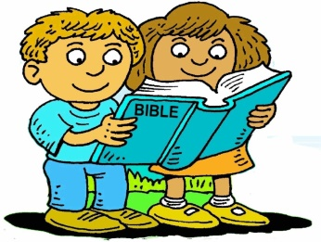
Booneville Church of Christ Kindergarten Bible Class
Quarter 2, Lesson 1
Today’s Lesson | Jesus Birth Matt. 1:18-25; Luke 1:26-38; 2:1-39
Bible Words We Learned | Swaddling clothes – strips of cloth that were wrapped around a baby Manger – A feeding trough for animals
Questions for Review | Who was Jesus’ Mother? Mary Who was Mary’s husband? Joseph In what town was Jesus born? Bethlehem
Bible Skills to Practice | An adult should look up Luke, chapter 1. Ask the student to point to the book name in the upper corners of the page and locate the big number “1.”
Memory Work | John 3:16 ⁻For God so loved the world that He gave His only begotten Son, that whoever believes in Him should not perish but have everlasting life. (NKJV) 12 Apostles Books of the Bible
Next Week’s Lesson | Jesus Boyhood; Visit to the Temple Luke 2:39-52

Slide 2
Booneville Church of Christ Kindergarten Bible Class
Quarter 2, Lesson 2
Today’s Lesson | Jesus Boyhood; Visit to the Temple Luke 2:39-52
Bible Words We Learned | Rabbi – a Jewish word for teacher
Questions for Review | How old was Jesus when he went to Jerusalem? 12 Why did his family go to Jerusalem? To keep the Passover Where did Mary and Joseph find Jesus? In the temple
Bible Skills to Practice | An adult should look up Luke, chapter 2. Ask the student to point to the book name in the upper corners of the page and locate the big number “2.”
Memory Work | John 3:16 ⁻For God so loved the world that He gave His only begotten Son, that whoever believes in Him should not perish but have everlasting life. (NKJV) 12 Apostles Books of the Bible
Next Week’s Lesson | John the Baptizer Luke 1; Luke 3; Mark 1:1-8; Matthew 3:1-12

Slide 3
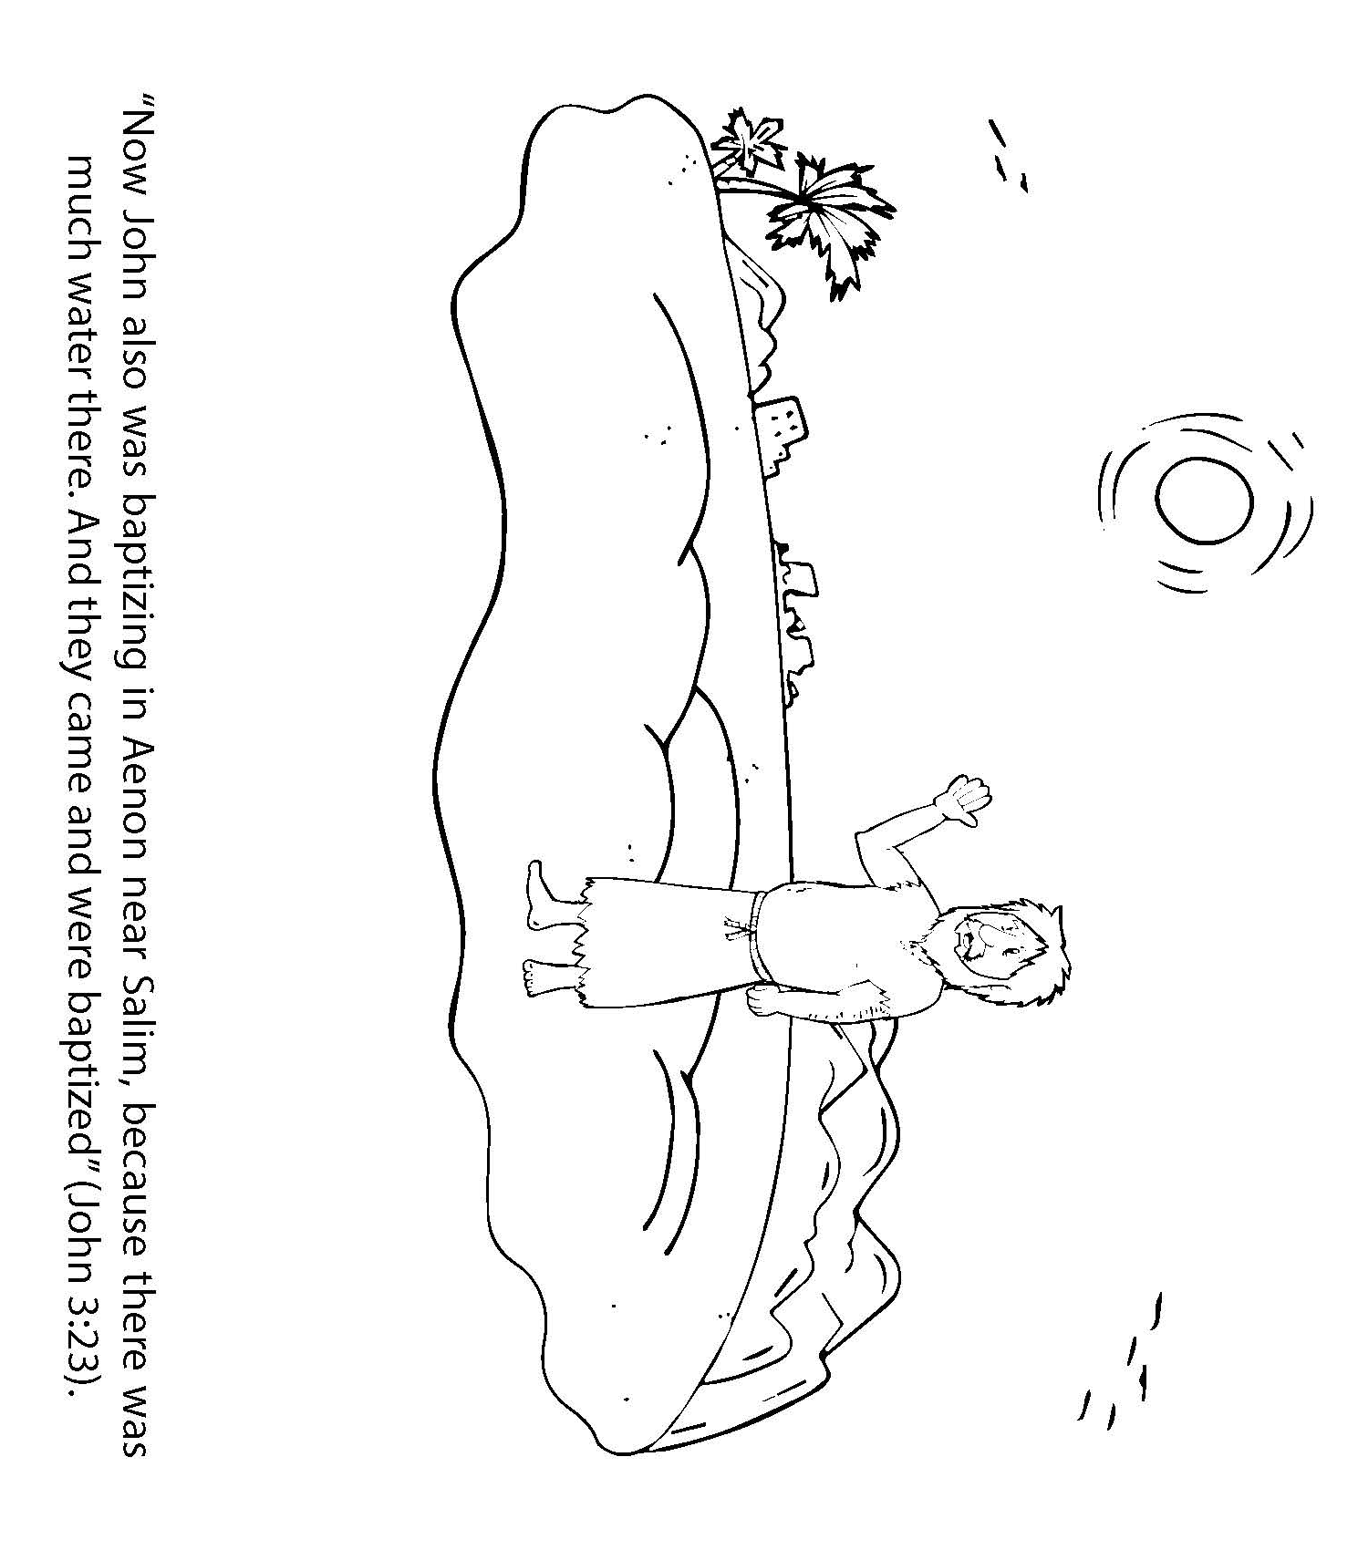
Booneville Church of Christ Kindergarten Bible Class
Quarter 2, Lesson 3
Today’s Lesson | John the Baptizer Luke 1; Luke 3; Mark 1:1-8; Matthew 3:1-12
Questions for Review | Who were John’s parents? Zachariah and Elizabeth What could Zachariah not do after he saw the angel? Speak When was he able to speak again? When he wrote that his son’s name would be John What was John’s purpose? To prepare the way for the Messiah (Jesus)
Bible Skills to Practice | An adult should look up Mark, chapter 1. Ask the student to point to the book name in the upper corners of the page and locate the big number “1.”
Memory Work | John 3:16 ⁻For God so loved the world that He gave His only begotten Son, that whoever believes in Him should not perish but have everlasting life. (NKJV) 12 Apostles Books of the Bible
Next Week’s Lesson | Jesus Baptism and Temptation Matthew 3, 4; Mark 1:9-13; Luke 3-4; John 1:29-34

Slide 4
Booneville Church of Christ Kindergarten Bible Class
Quarter 2, Lesson 4
Today’s Lesson | Jesus Baptism (Sunday) and Temptation (Wednesday) Matthew 3, 4; Mark 1:9-13; Luke 3-4; John 1:29-34
Bible Words We Learned | Baptize – To immerse , dip down. In the Bible, the immersion takes place in water
Questions for Review | Who baptized Jesus? John How old was Jesus? 30 How long did Jesus not eat after his baptism? 40 days What was the first thing Satan tried to tempt Jesus with? Food
Bible Skills to Practice | An adult should look up Luke, chapter 3. Ask the student to point to the book name in the upper corners of the page and locate the big number “3.”
Memory Work | John 3:16 ⁻For God so loved the world that He gave His only begotten Son, that whoever believes in Him should not perish but have everlasting life. (NKJV) 12 Apostles Books of the Bible
Next Week’s Lesson | The Wedding at Cana John 2

Slide 5
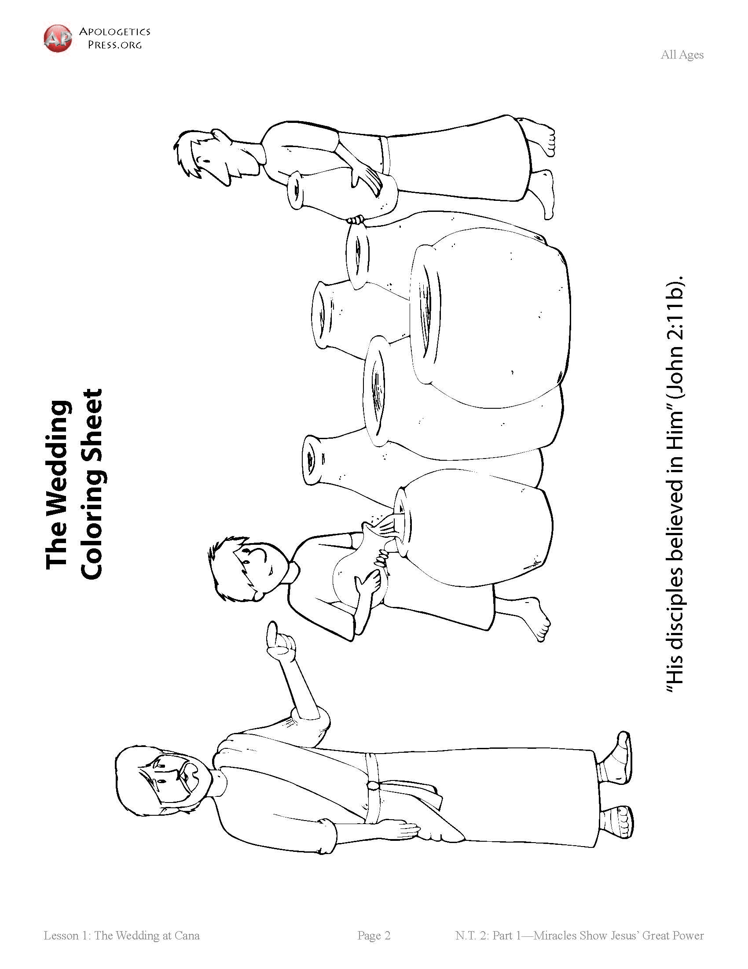
Booneville Church of Christ Kindergarten Bible Class
Quarter 2, Lesson 5
Today’s Lesson | The Wedding at Cana John 2
Bible Words We Learned | Miracle – an extraordinary event that happens by God’s power. It is not something that could occur naturally
Questions for Review | What was Jesus’ first public miracle? Turning water to wine Why did Jesus perform this miracle? His mother asked him to.
Bible Skills to Practice | An adult should look up John, chapter 2. Ask the student to point to the book name in the upper corners of the page and locate the big number “2.”
Memory Work | John 3:16 ⁻For God so loved the world that He gave His only begotten Son, that whoever believes in Him should not perish but have everlasting life. (NKJV) 12 Apostles Books of the Bible
Next Week’s Lesson | Jesus Chooses 12 Apostles Matthew 10; Mark 3, Luke 6

Slide 6
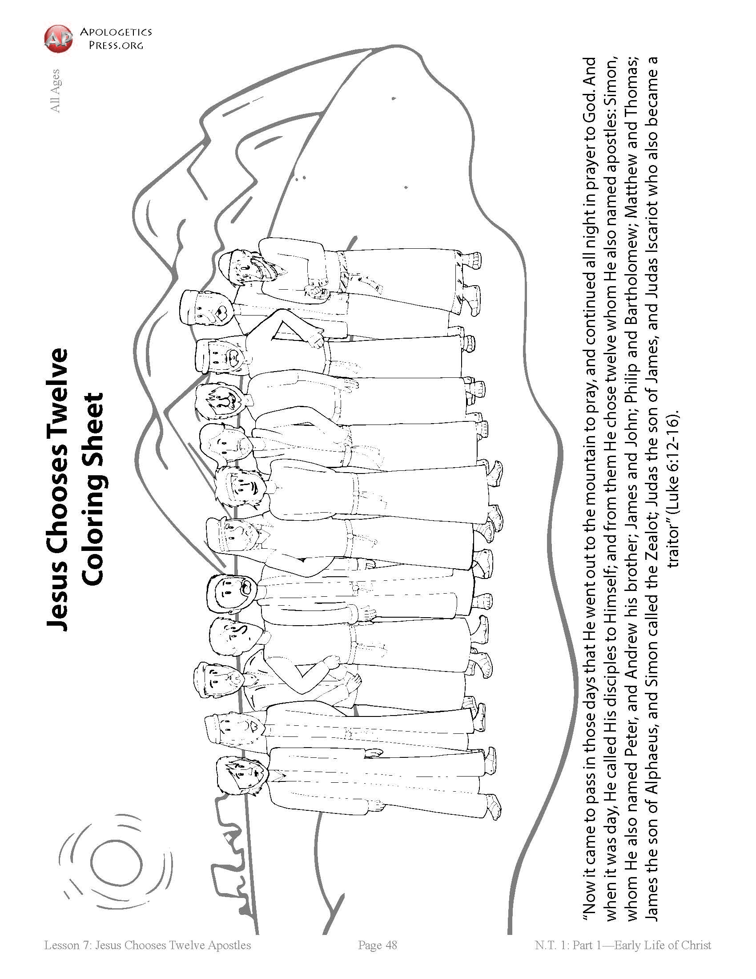
Booneville Church of Christ Kindergarten Bible Class
Quarter 2, Lesson 6
Today’s Lesson | Jesus Chooses 12 Apostles Matthew 10; Mark 3, Luke 6
Bible Words We Learned | Disciple – a follower of a certain teacher Apostle – a man chosen by Jesus to be a special preacher; lit. one sent forth
Questions for Review | Which apostles were fishermen? Peter, Andrew, James, and John Jesus told the fishermen to follow him and become fishers of __________. men How many apostles did Jesus choose? 12
Bible Skills to Practice | An adult should look up Luke, chapter 6. Ask the student to point to the book name in the upper corners of the page and locate the big number “6.”
Memory Work | John 3:16 ⁻For God so loved the world that He gave His only begotten Son, that whoever believes in Him should not perish but have everlasting life. (NKJV) 12 Apostles Books of the Bible
Next Week’s Lesson | Jesus Heals a Paralytic Luke 5: 17-26

Slide 7
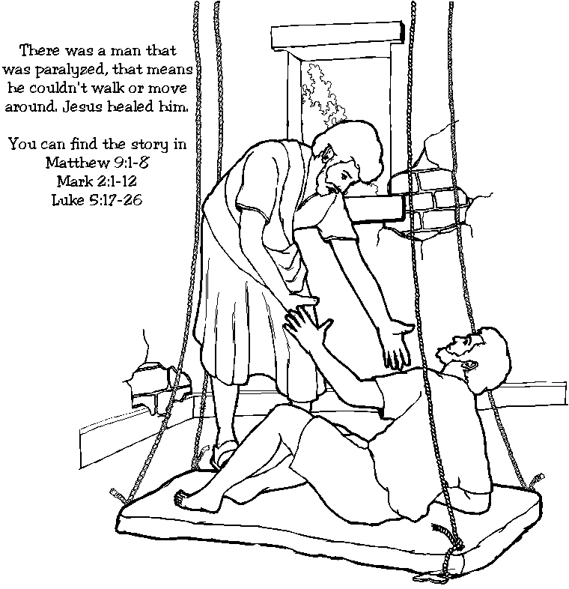
Booneville Church of Christ Kindergarten Bible Class
Quarter 2, Lesson 7
Today’s Lesson | Jesus Heals a Paralytic Luke 5: 17-26
Bible Words We Learned | Paralyzed – having part of the body that can’t move
Questions for Review | What was Jesus doing in the house? Teaching How did the lame man get to the house? His four friends carried him. How did he get in the house? He went through a hole in the roof.
Bible Skills to Practice | An adult should look up Luke, chapter 5. Ask the student to point to the book name in the upper corners of the page and locate the big number “5.”
Memory Work | John 3:16 ⁻For God so loved the world that He gave His only begotten Son, that whoever believes in Him should not perish but have everlasting life. (NKJV) 12 Apostles Books of the Bible
Next Week’s Lesson | Listen and Obey; Wise and Foolish Builders Matthew 7; Luke 6

Slide 8
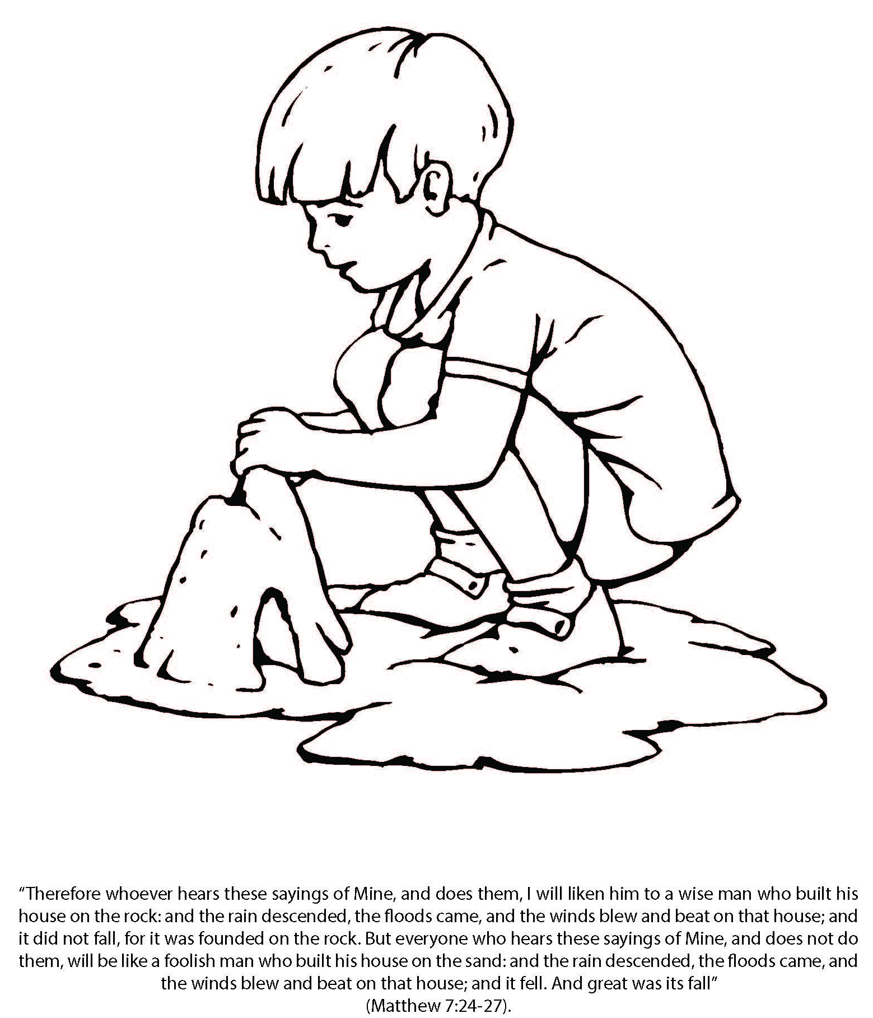
Booneville Church of Christ Kindergarten Bible Class
Quarter 2, Lesson 8
Today’s Lesson | Listen and Obey; Wise and Foolish Builders Matthew 7; Luke 6
Bible Words We Learned | Wise – showing good judgement Foolish – lacking good sense or judgement
Questions for Review | What did the foolish man build his house on? Sand What did the wise man build his house on? A rock How did Jesus say we can be wise? Listen to Jesus and do what he says.
Bible Skills to Practice | An adult should look up Luke, chapter 6. Ask the student to point to the book name in the upper corners of the page and locate the big number “6.”
Memory Work | John 3:16 ⁻For God so loved the world that He gave His only begotten Son, that whoever believes in Him should not perish but have everlasting life. (NKJV) 12 Apostles Books of the Bible
Next Week’s Lesson | Jesus Calms a Storm Matthew 8; Luke 8

Slide 9
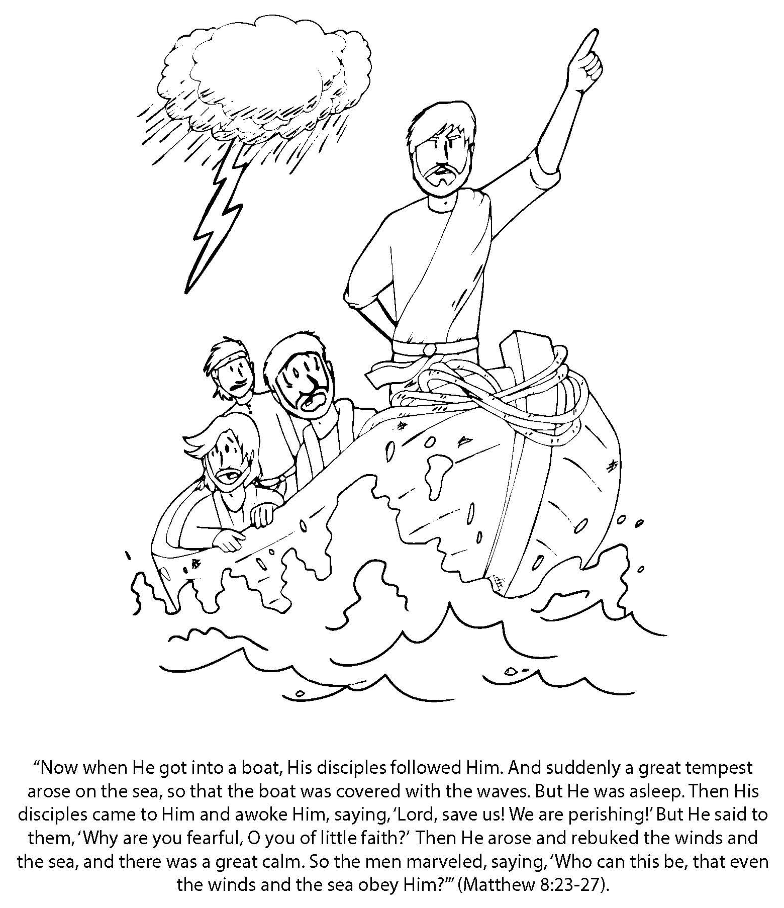
Booneville Church of Christ Kindergarten Bible Class
Quarter 2, Lesson 9
Today’s Lesson | Jesus Calms a Storm Matthew 8; Luke 8
Questions for Review | What did Jesus do when he got on the boat? Went to sleep What happened on the sea? A bad storm What did the disciples say to Jesus when the woke him up? Don’t you care that we are about to die? Save us. What did Jesus do? He told the storm to be still and it stopped.
Bible Skills to Practice | An adult should look up Luke, chapter 8. Ask the student to point to the book name in the upper corners of the page and locate the big number “8.”
Memory Work | John 3:16 ⁻For God so loved the world that He gave His only begotten Son, that whoever believes in Him should not perish but have everlasting life. (NKJV) 12 Apostles Books of the Bible
Next Week’s Lesson | Jesus Heals a Woman/Raises Jairus’ Daughter Matthew 7; Luke 6

Slide 10
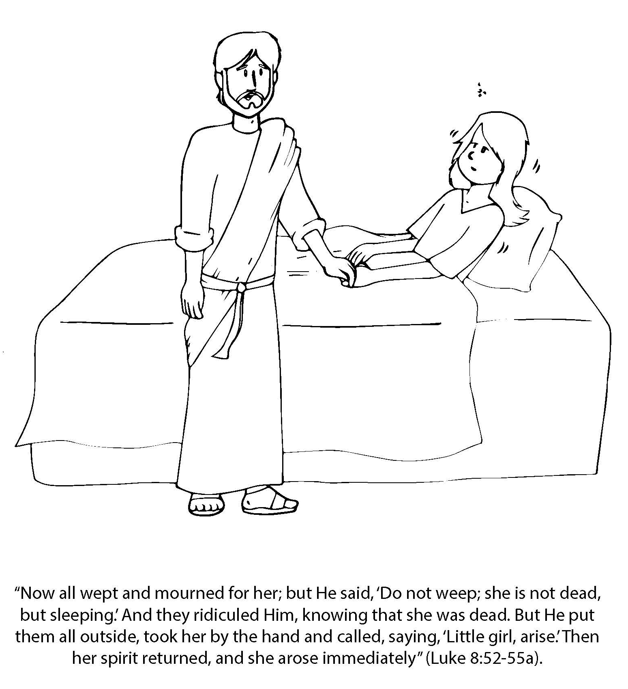
Booneville Church of Christ Kindergarten Bible Class
Quarter 2, Lesson 10
Today’s Lesson | Jesus Heals a Woman/Raises Jairus’ Daughter Matthew 7; Luke 6
Questions for Review | Who wanted Jesus to heal his sick daughter? Jairus How was a woman in the crowd healed? She touched Jesus’ clothes What happened to Jairus’ daughter? She died before Jesus got to her house What did Jesus do? He told the girl to get up and she came back to life.
Bible Skills to Practice | An adult should look up Matthew, chapter 7. Ask the student to point to the book name in the upper corners of the page and locate the big number “7.”
Memory Work | John 3:16 ⁻For God so loved the world that He gave His only begotten Son, that whoever believes in Him should not perish but have everlasting life. (NKJV) 12 Apostles Books of the Bible
Next Week’s Lesson | Jesus Feeds Multitudes Luke 9

Slide 11
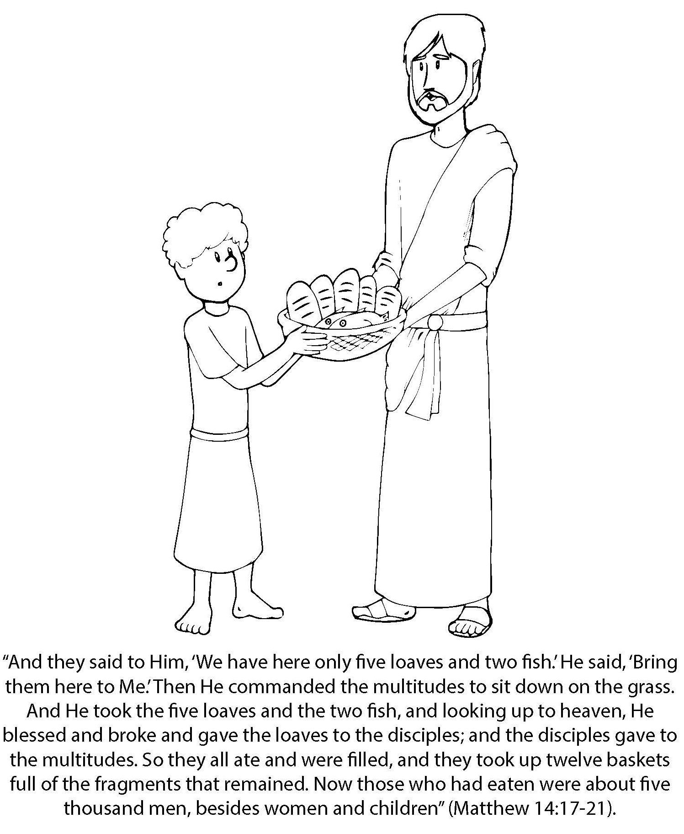
Booneville Church of Christ Kindergarten Bible Class
Quarter 2, Lesson 11
Today’s Lesson | Jesus Feeds Multitudes Luke 9
Bible Words We Learned | Compassion- sharing someone’s sadness; wanting to help others who are in trouble or need help
Questions for Review | How many people were in the crowd? 5,000 men (not including women and children) What did Jesus use to feed the people? A boy’s lunch of 5 loaves of bread and 2 fish How was this enough to feed a crowd? Jesus made more food from the boy’s lunch
Bible Skills to Practice | An adult should look up Luke, chapter 9. Ask the student to point to the book name in the upper corners of the page and locate the big number “9.”
Memory Work | John 3:16 ⁻For God so loved the world that He gave His only begotten Son, that whoever believes in Him should not perish but have everlasting life. (NKJV) 12 Apostles Books of the Bible
Next Week’s Lesson | Jesus Walks on Water Matthew 14

Slide 12
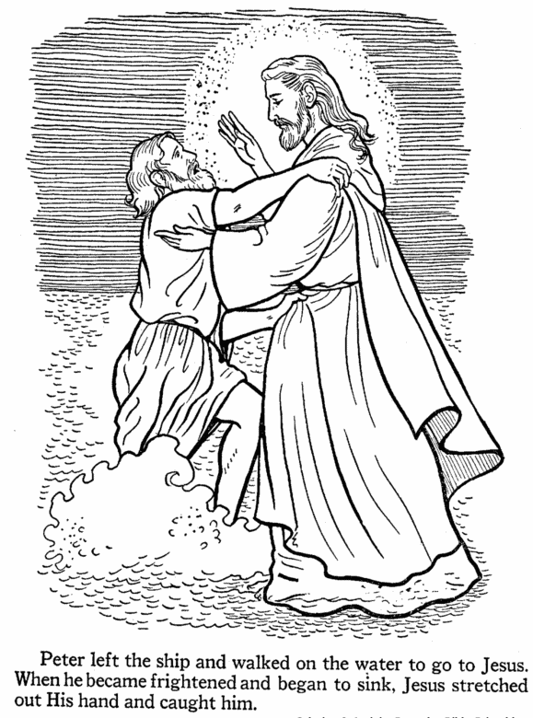
Booneville Church of Christ Kindergarten Bible Class
Quarter 2, Lesson 12
Today’s Lesson | Jesus Walks on Water Matthew 14
Questions for Review | How did Jesus come to the boat? He walked on water Which apostle walked on water to Jesus? Peter Why did Peter sink? He was afraid of the waves
Bible Skills to Practice | An adult should look up Matthew, chapter 14. Ask the student to point to the book name in the upper corners of the page and locate the big number “14.”
Memory Work | John 3:16 ⁻For God so loved the world that He gave His only begotten Son, that whoever believes in Him should not perish but have everlasting life. (NKJV) 12 Apostles Books of the Bible
Next Week’s Lesson | Mary and Martha Luke 10

Slide 13
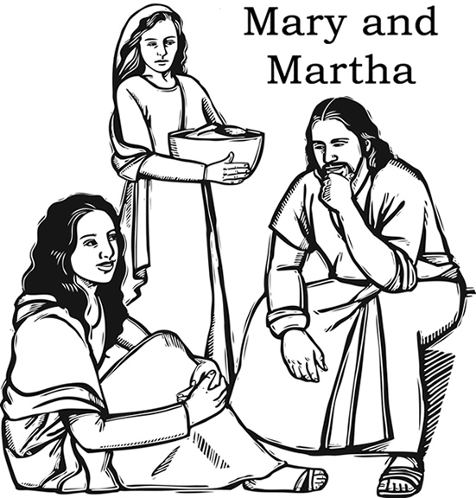
Booneville Church of Christ Kindergarten Bible Class
Quarter 2, Lesson 13
Today’s Lesson | Mary and Martha Luke 10
Questions for Review | Who were Jesus’ good friends in Bethany? Mary, Martha, and Lazarus Why was Martha upset? Mary would not help her with the cooking; instead, she sat at Jesus feet listening to Him speak What did Jesus tell Martha? She was worried about too many things. Mary had chosen the good part which would not be taken away from her.
Bible Skills to Practice | An adult should look up Luke, chapter 10. Ask the student to point to the book name in the upper corners of the page and locate the big number “10.”
Memory Work | John 3:16 ⁻For God so loved the world that He gave His only begotten Son, that whoever believes in Him should not perish but have everlasting life. (NKJV) 12 Apostles Books of the Bible
Next Week’s Lesson | The Good Samaritan Luke 10

