Slide 1
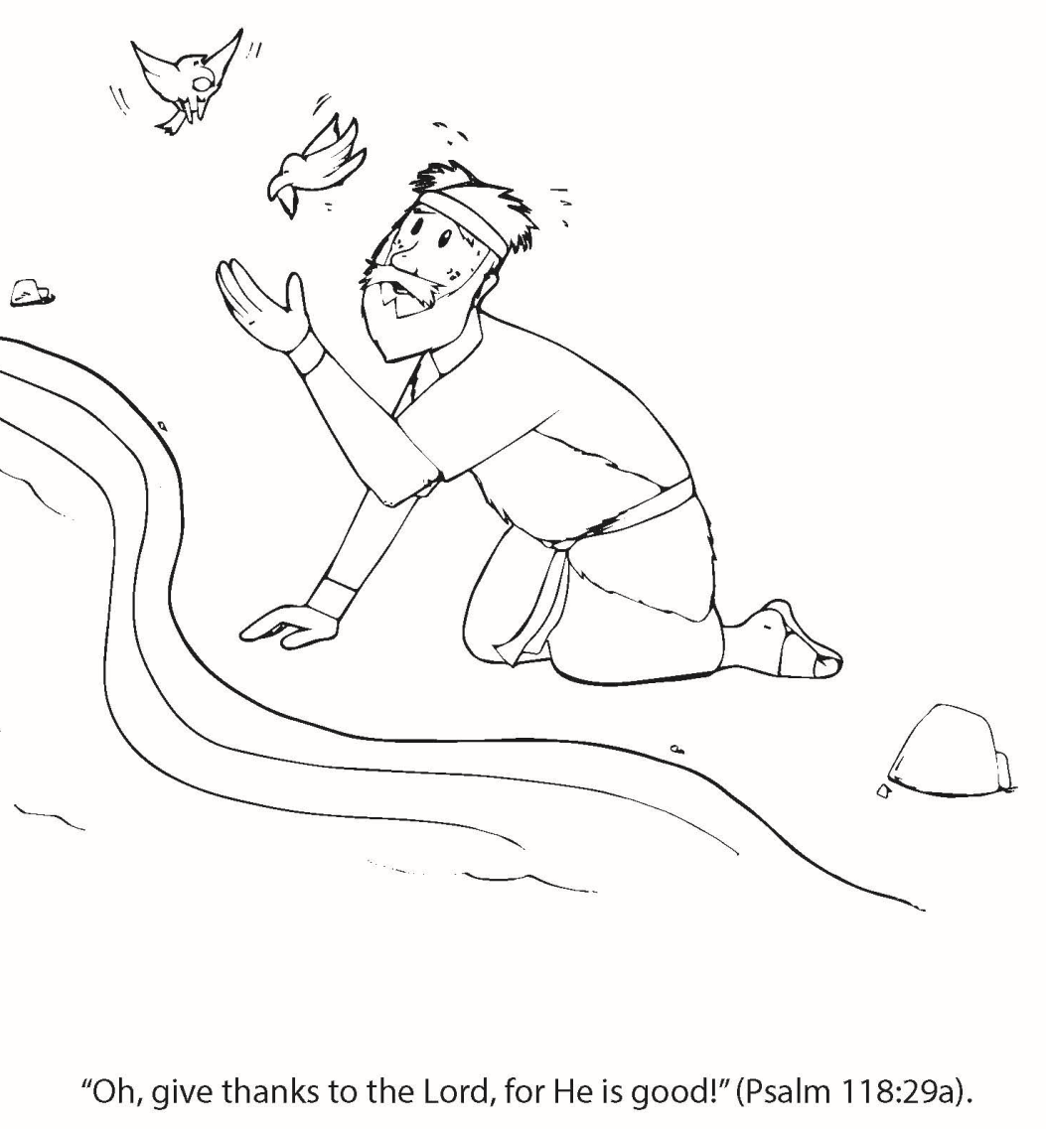
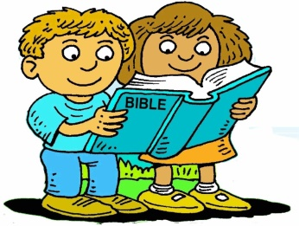
Booneville Church of Christ Kindergarten Bible Class
Quarter 1, Lesson 1
Today’s Lesson | God Takes Care of Elijah I Kings 17
Bible Words We Learned | Prophet – one chosen by God as a messenger Drought – a time of little to no rain Widow – a woman whose husband has died
Questions for Review | Who was the evil king? Ahab How did God feed Elijah during the drought? Ravens brought him food and he drank from the brook. Later, a widow shared her food with him.
Bible Skills to Practice | Find the Old Testament in your Bible
Memory Work | Psalm 119:105 – Your word is a lamp to my feet and a light to my path. Books of the Bible
Next Week’s Lesson | Elijah on Mt. Carmel I Kings 18

Slide 2
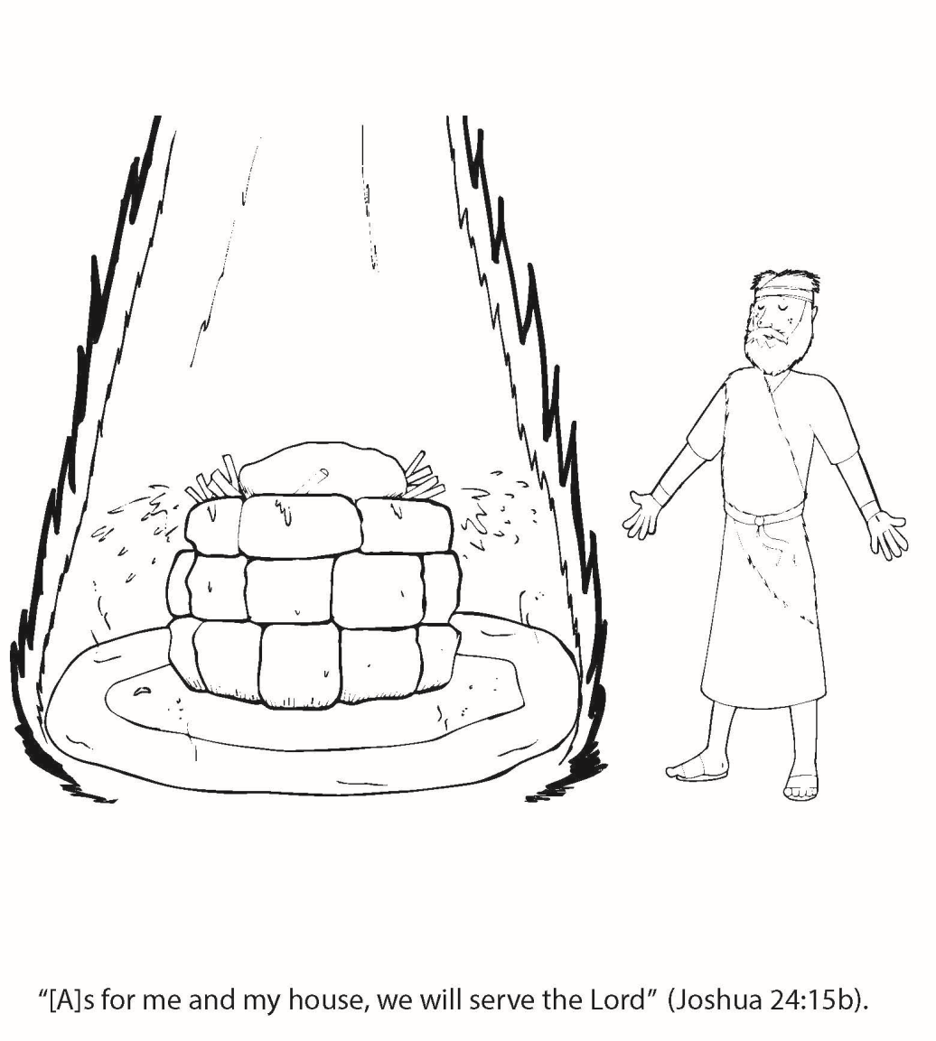
Booneville Church of Christ Kindergarten Bible Class
Quarter 1, Lesson 2
Today’s Lesson | Elijah on Mt. Carmel I Kings 18
Bible Words We Learned | Famine –a time of very little food, usually caused by a drought Altar – a raised structure on which sacrifices were made
Questions for Review | Who was Baal? A false or made up god How did Elijah challenge Baal’s prophets? An altar was built to Baal and to God. The one that sent fire from Heaven was the true God.
Bible Skills to Practice | Find the Old Testament in your Bible
Memory Work | Psalm 119:105 – Your word is a lamp to my feet and a light to my path. Books of the Bible
Next Week’s Lesson | Elisha Takes Elijah’s Place/The Shunamite Woman I Kings 19; II Kings 2-4

Slide 3
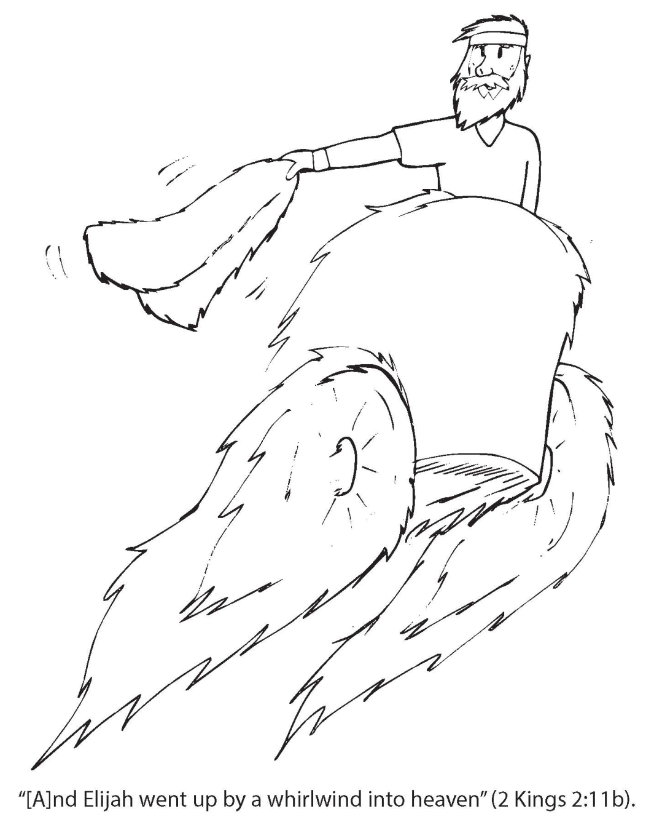
Booneville Church of Christ Kindergarten Bible Class
Quarter 1, Lesson 3
Today’s Lesson | Elisha Takes Elijah’s Place/The Shunamite Woman I Kings 19; II Kings 2-4
Questions for Review | Who took Elijah’s place? Elisha What nice thing did the family in Shunem do for Elisha? They made a room for him on top of their house so he would have a place to stay when he passed through town. (Wed. lesson) What did Elisha do for the woman? He asked God to give her a son. Later he raised the son from the dead.
Bible Skills to Practice | Find the Old Testament in your Bible.
Memory Work | Psalm 119:105 – Your word is a lamp to my feet and a light to my path. Books of the Bible
Next Week’s Lesson | Naaman II Kings 5

Slide 4
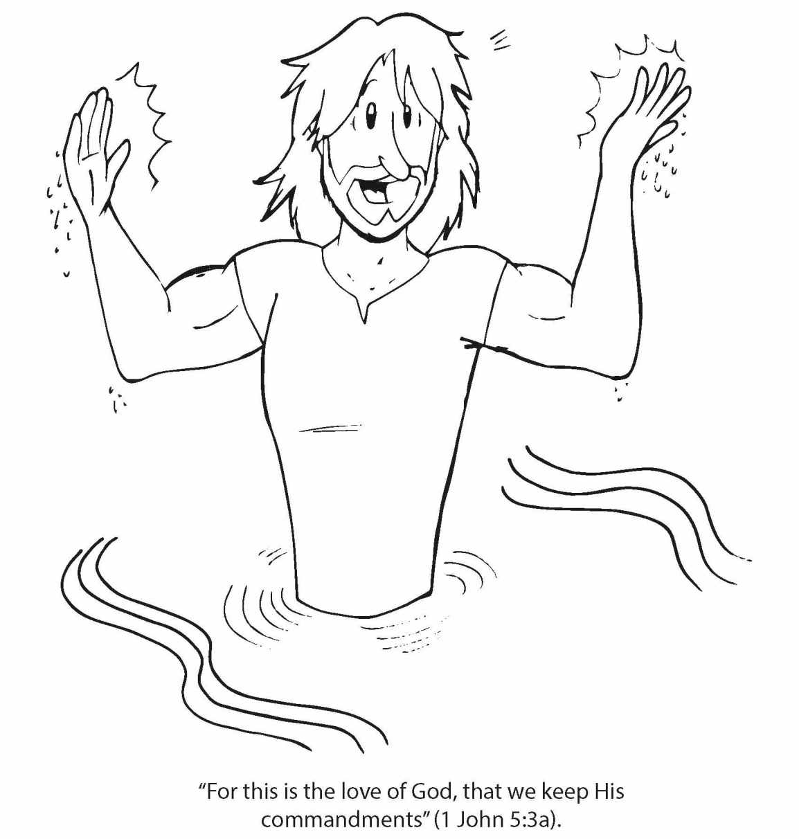
Booneville Church of Christ Kindergarten Bible Class
Quarter 1, Lesson 4
Today’s Lesson | Naaman II Kings 5
Bible Words We Learned | Leprosy – a skin disease for which there was no cure
Questions for Review | Why did Naaman visit Elisha? He was looking for a cure for his leprosy. What were Elisha’s instructions to Naaman? Dip in the Jordan River 7 times to be cleansed.
Bible Skills to Practice | Find the Old Testament in your Bible
Memory Work | Psalm 119:105 – Your word is a lamp to my feet and a light to my path. Books of the Bible
Next Week’s Lesson | Jonah The Book of Jonah

Slide 5
Booneville Church of Christ Kindergarten Bible Class
Quarter 1, Lesson 5
Today’s Lesson | Jonah The Book of Jonah
Questions for Review | How did Jonah disobey God? God told him to go to Nineveh, but he went to Tarshish and got on a boat. What was Jonah’s punishment? God sent a storm when he was on the boat. After he was thrown off the boat a great fish swallowed him. How long was Jonah in the fish? 3 days
Bible Skills to Practice | Find the Old Testament in your Bible.
Memory Work | Psalm 119:105 – Your word is a lamp to my feet and a light to my path. Books of the Bible
Next Week’s Lesson | Daniel and his Three Friends Daniel 1

Slide 6
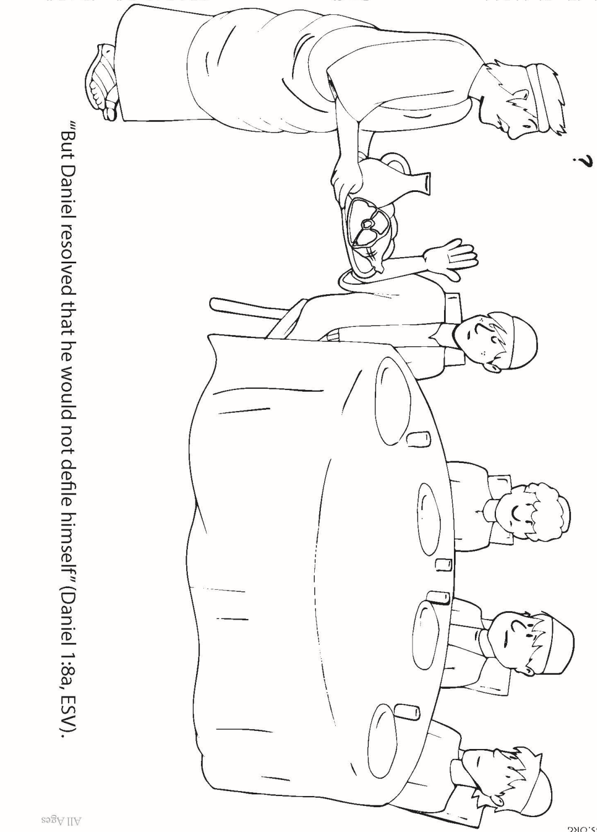
Booneville Church of Christ Kindergarten Bible Class
Quarter 1, Lesson 6
Today’s Lesson | Daniel and his Three Friends Daniel 1
Bible Words We Learned | Captivity – a time of being held, imprisoned, or enslaved. The Jews were taken into captivity by King Nebuchadnezzer.
Questions for Review | Who were the 4 young men that would not eat the king’s food? Daniel, Shadrach, Meshach, and Abednego.
Bible Skills to Practice | Let a grown up locate the book of Daniel in your Bible. Find the book name in the top outer corners. Find the big number 1 for chapter 1.
Memory Work | Psalm 119:105 – Your word is a lamp to my feet and a light to my path. Books of the Bible
Next Week’s Lesson | The Fiery Furnace Daniel 3

Slide 7
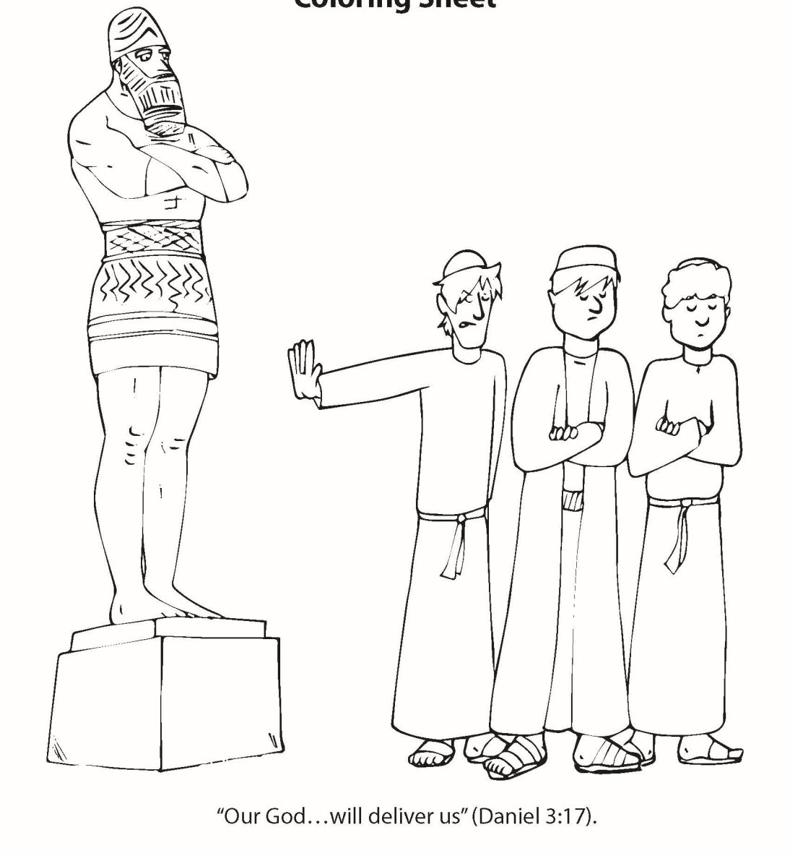
Booneville Church of Christ Kindergarten Bible Class
Quarter 1, Lesson 7
Today’s Lesson | The Fiery Furnace Daniel 3
Bible Words We Learned | Idol – an image or object representing a god
Questions for Review | What were the people supposed to do when the music played? Bow down to the statue What happened when Shadrach, Meshach, and Abednego did not bow down? They were thrown into a fiery furnace. Did they die? No. God protected them.
Bible Skills to Practice | Let a grown up locate the book of Daniel in your Bible. Find the book name in the top outer corners. Find the big number 3 for chapter 3.
Memory Work | Psalm 119:105 – Your word is a lamp to my feet and a light to my path. Books of the Bible
Next Week’s Lesson | Nebuchadnezzar is Humbled Daniel 4

Slide 8
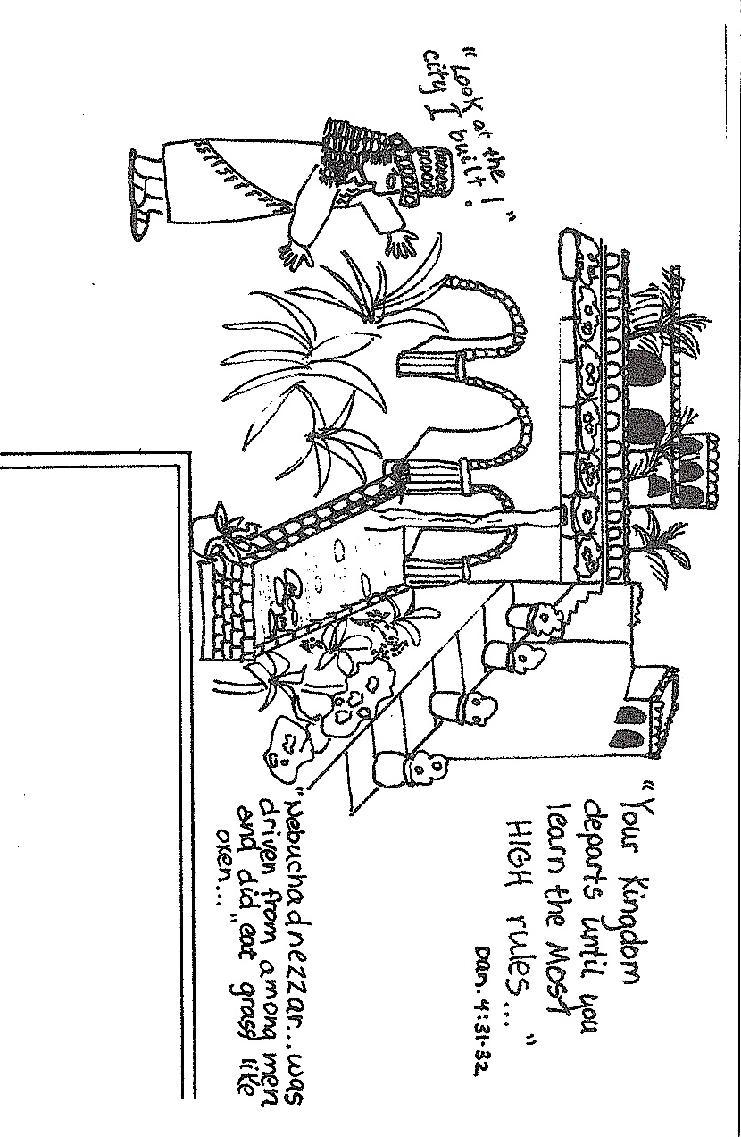
Booneville Church of Christ Kindergarten Bible Class
Quarter 1, Lesson 8
Today’s Lesson | Nebuchadnezzar is Humbled Daniel 4
Questions for Review | Why did God punish Nebuchadnezzar? He took credit for the greatness of his kingdom instead of giving glory to God. How was he punished? He lived like a wild animal for 7 years.
Bible Skills to Practice | Let a grown up locate the book of Daniel in your Bible. Find the book name in the top outer corners. Find the big number 4 for chapter 4.
Memory Work | Psalm 119:105 – Your word is a lamp to my feet and a light to my path. Books of the Bible
Next Week’s Lesson | Belshazzar’s Feast Daniel 5

Slide 9
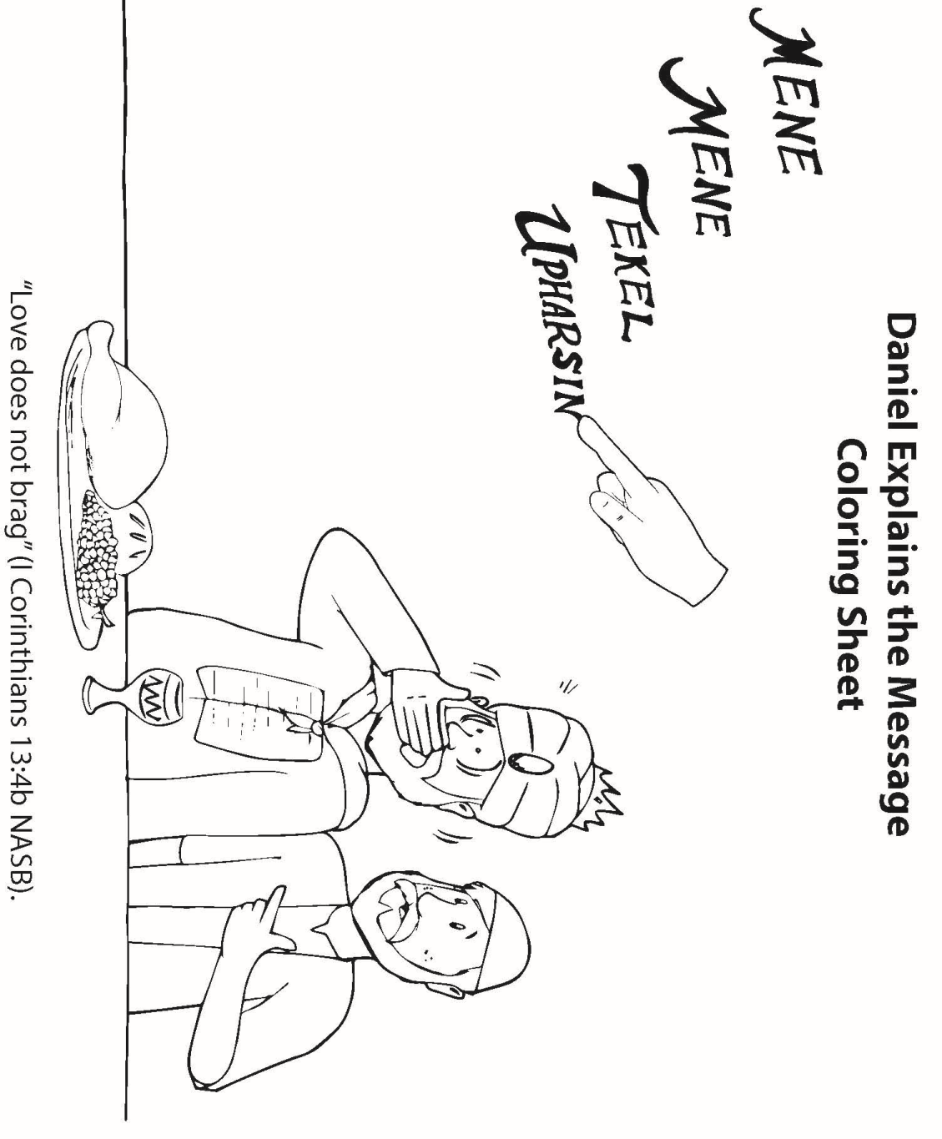
Booneville Church of Christ Kindergarten Bible Class
Quarter 1, Lesson 9
Today’s Lesson | Belshazzar’s Feast Daniel 5
Questions for Review | What did the king see writing on the wall? A hand What did the message on the wall mean? The king had been judged as unfaithful to God. Belshazzar’s kingdom would come to an end. His empire would be taken over by the Medes and Persians.
Bible Skills to Practice | Let a grown up locate the book of Daniel in your Bible. Find the book name in the top outer corners. Find the big number 5 for chapter 5.
Memory Work | Psalm 119:105 – Your word is a lamp to my feet and a light to my path. Books of the Bible
Next Week’s Lesson | Daniel in the Lion’s Den Daniel 6

Slide 10
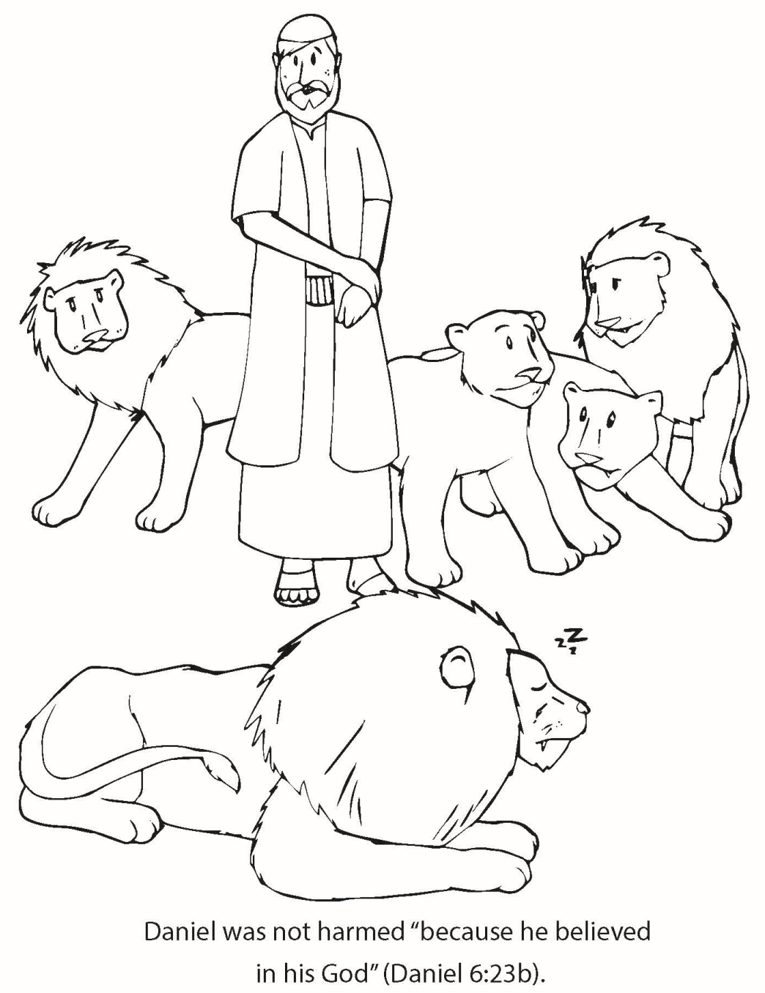
Booneville Church of Christ Kindergarten Bible Class
Quarter 1, Lesson 10
Today’s Lesson | Daniel in the Lion’s Den Daniel 6
Questions for Review | Why did Daniel get thrown into with the lions? A law said no one could worship anyone except the king. But, Daniel continued praying to God. Did the lions hurt Daniel? No. God sent an angel to shut the lions’ mouths.
Bible Skills to Practice | Let a grown up locate the book of Daniel in your Bible. Find the book name in the top outer corners. Find the big number 6 for chapter 6.
Memory Work | Psalm 119:105 – Your word is a lamp to my feet and a light to my path. Books of the Bible
Next Week’s Lesson | Esther The Book of Esther

Slide 11
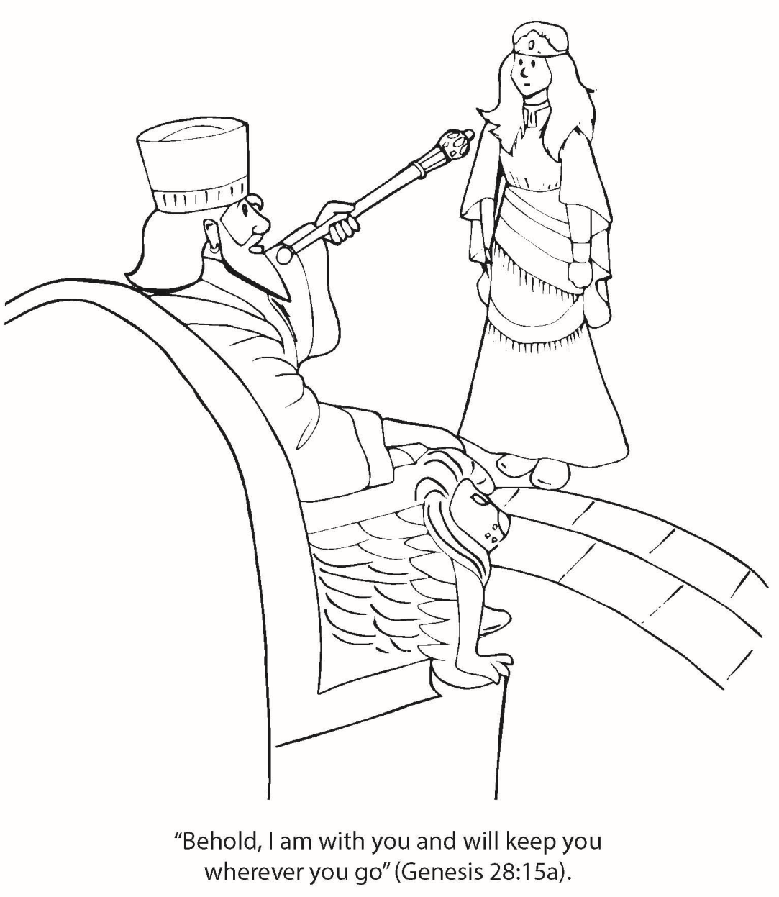
Booneville Church of Christ Kindergarten Bible Class
Quarter 1, Lesson 11
Today’s Lesson | Esther The Book of Esther
Questions for Review | Who was Mordecai? Esther’s Uncle. What did Mordecai do that made Haman angry? He would not bow down to him. What did Haman do to punish Mordecai? He had the king sign a letter for the Jews to be killed. How did Esther help? She went to the king to ask for the king to save the Jews. The king allowed the Jews to fight and the Jews won.
Bible Skills to Practice | Let a grown up locate the book of Esther. Find the book name in the top outer corners.
Memory Work | Psalm 119:105 – Your word is a lamp to my feet and a light to my path. Books of the Bible
Next Week’s Lesson | Ezra Teaches God’s Law Ezra; II Chronicles 36; Nehemiah 8

Slide 12
Booneville Church of Christ Kindergarten Bible Class
Quarter 1, Lesson 12
Today’s Lesson | Ezra Teaches God’s Law Ezra; II Chronicles 36; Nehemiah 8
Questions for Review | What did Zerubbabel and the Jews do in Jerusalem? They rebuilt the temple. What did Ezra want to do after he was given permission to go to Jerusalem? He wanted to teach the Jews God’s Law.
Bible Skills to Practice | Let a grown up locate the book of Ezra. Find the book name in the top outer corners.
Memory Work | Psalm 119:105 – Your word is a lamp to my feet and a light to my path. Books of the Bible
Next Week’s Lesson | Nehemiah The Book of Nehemiah

Slide 13
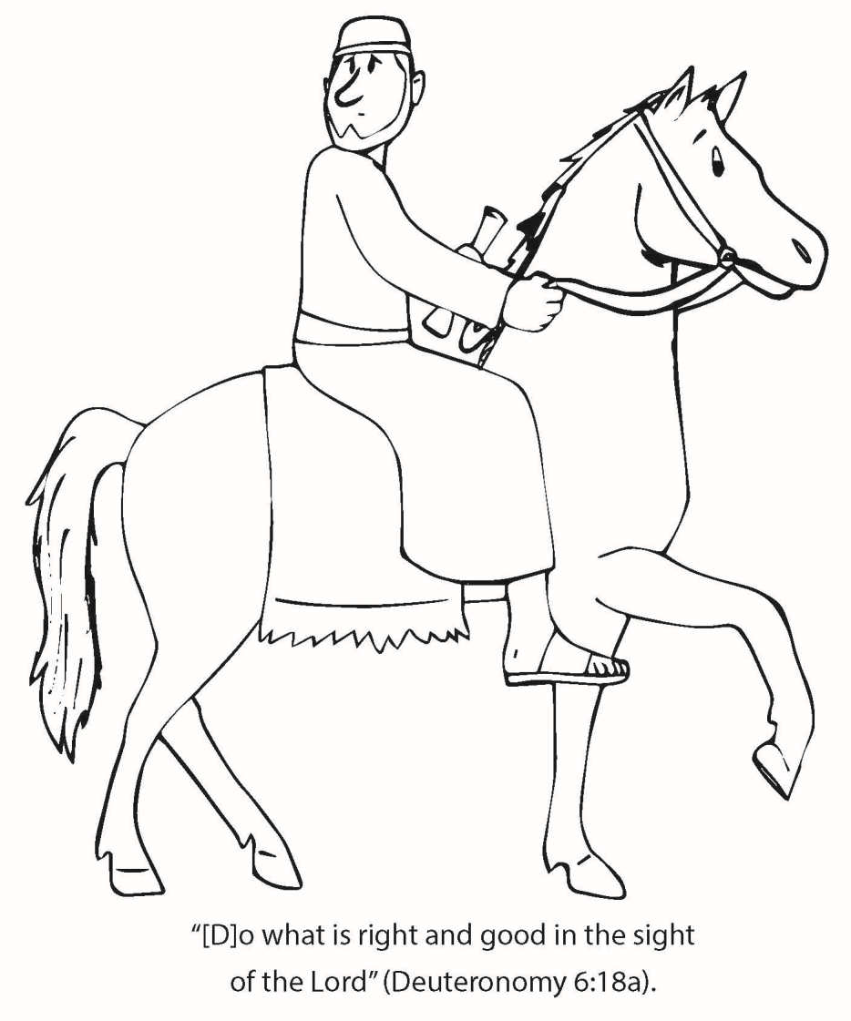
Booneville Church of Christ Kindergarten Bible Class
Quarter 1, Lesson 13
Today’s Lesson | Nehemiah The Book of Nehemiah
Questions for Review | What was Nehemiah’s job? He was cupbearer to the king What did he go back to Jerusalem to do? Rebuild the walls around Jerusalem How long did it take the Jews to complete their work? 52 days
Bible Skills to Practice | Let a grown up locate the book of Nehemiah. Find the book name in the top outer corners.
Memory Work | Psalm 119:105 – Your word is a lamp to my feet and a light to my path. Books of the Bible
Next Week’s Lesson | Jesus’ Birth Matthew 1; Luke 1-2

