Slide 1
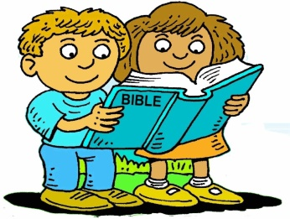
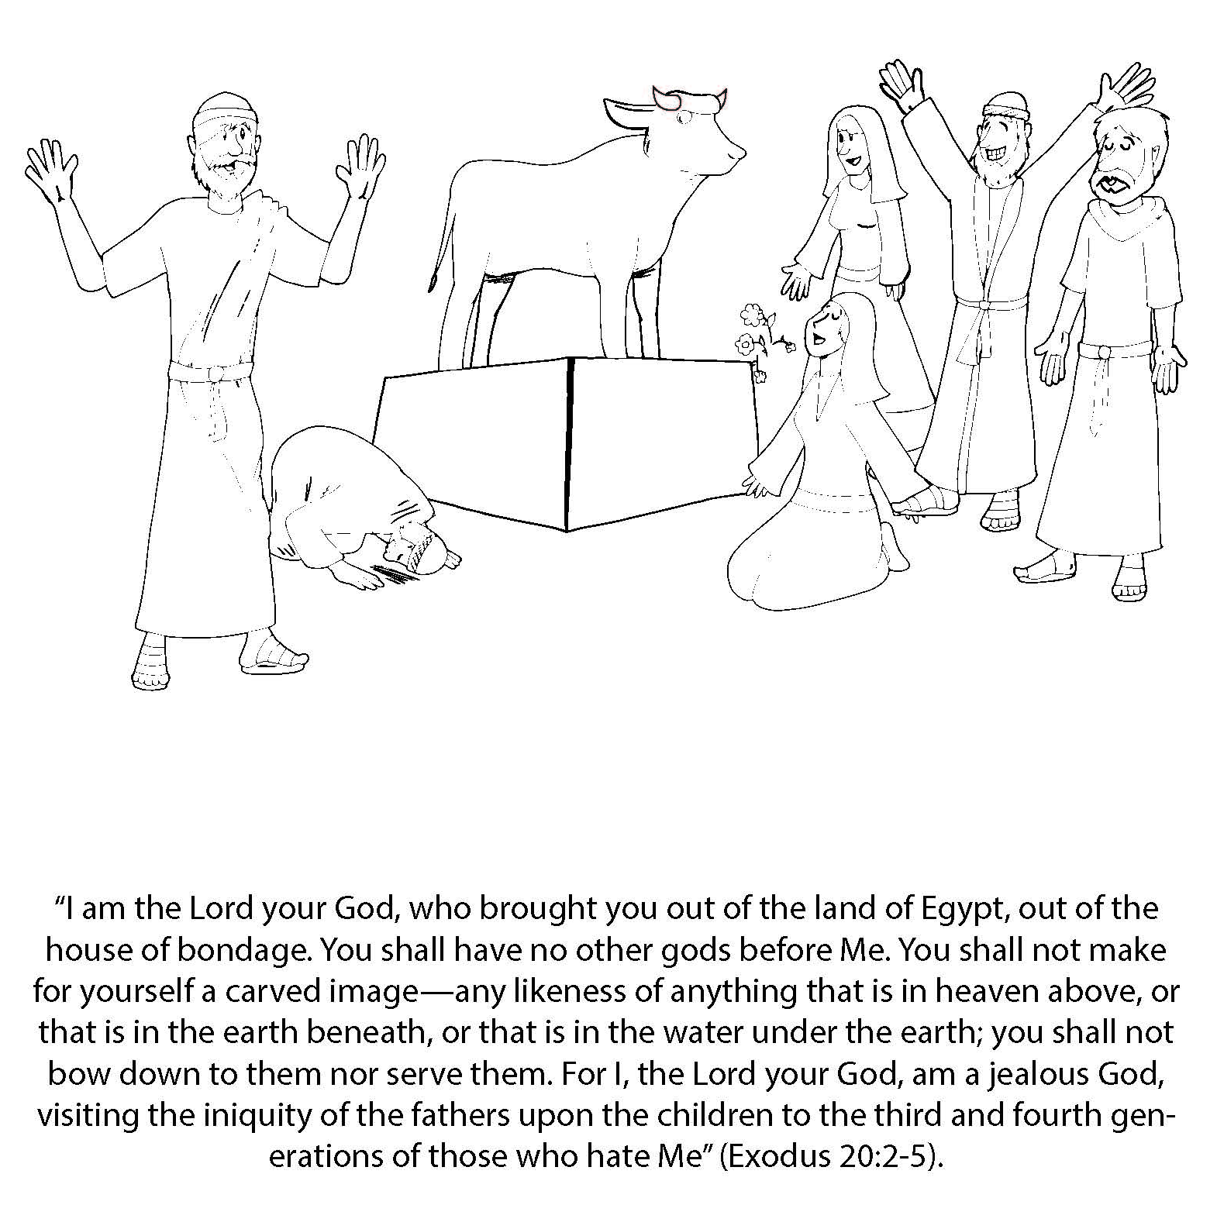
Booneville Church of Christ 4 Year Old Bible Class
Quarter 3, Lesson 1
Today’s Lesson | The Golden Calf Exodus 20:2-5, 32:1-35
Questions for Review | What did the people tell Aaron they wanted to worship? An idol What did Moses do when he saw the people worshiping the idol? He threw the tablets down and they broke. What did Moses do with the calf? He burned it, ground it into powder, put it into the people’s water, and made them drink it
Memory Work | Books of the Bible Joshua 1:9
Next Week’s Lesson | Building the Tabernacle Exodus 25:1-35:11

Slide 2
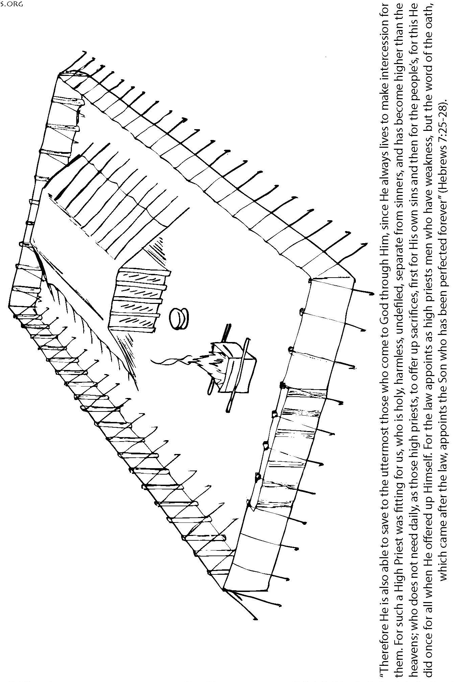
Booneville Church of Christ 4 Year Old Bible Class
Quarter 3, Lesson 2
Today’s Lesson | Building the Tabernacle Exodus 25:1-35:11
Questions for Review | God wanted the Israelites to have a special place to worship. What was it called? The tabernacle What were the two rooms inside the tabernacle? The Holy Place and the Most Holy Place What was in the Most Holy Place? The Ark of the Covenant (4) Who was allowed in the Most Holy Place? The High Priest, and only for one day: the Day of Atonement
Memory Work | Books of the Bible Joshua 1:9
Next Week’s Lesson | Nadab and Abihu Leviticus 10:1-7

Slide 3
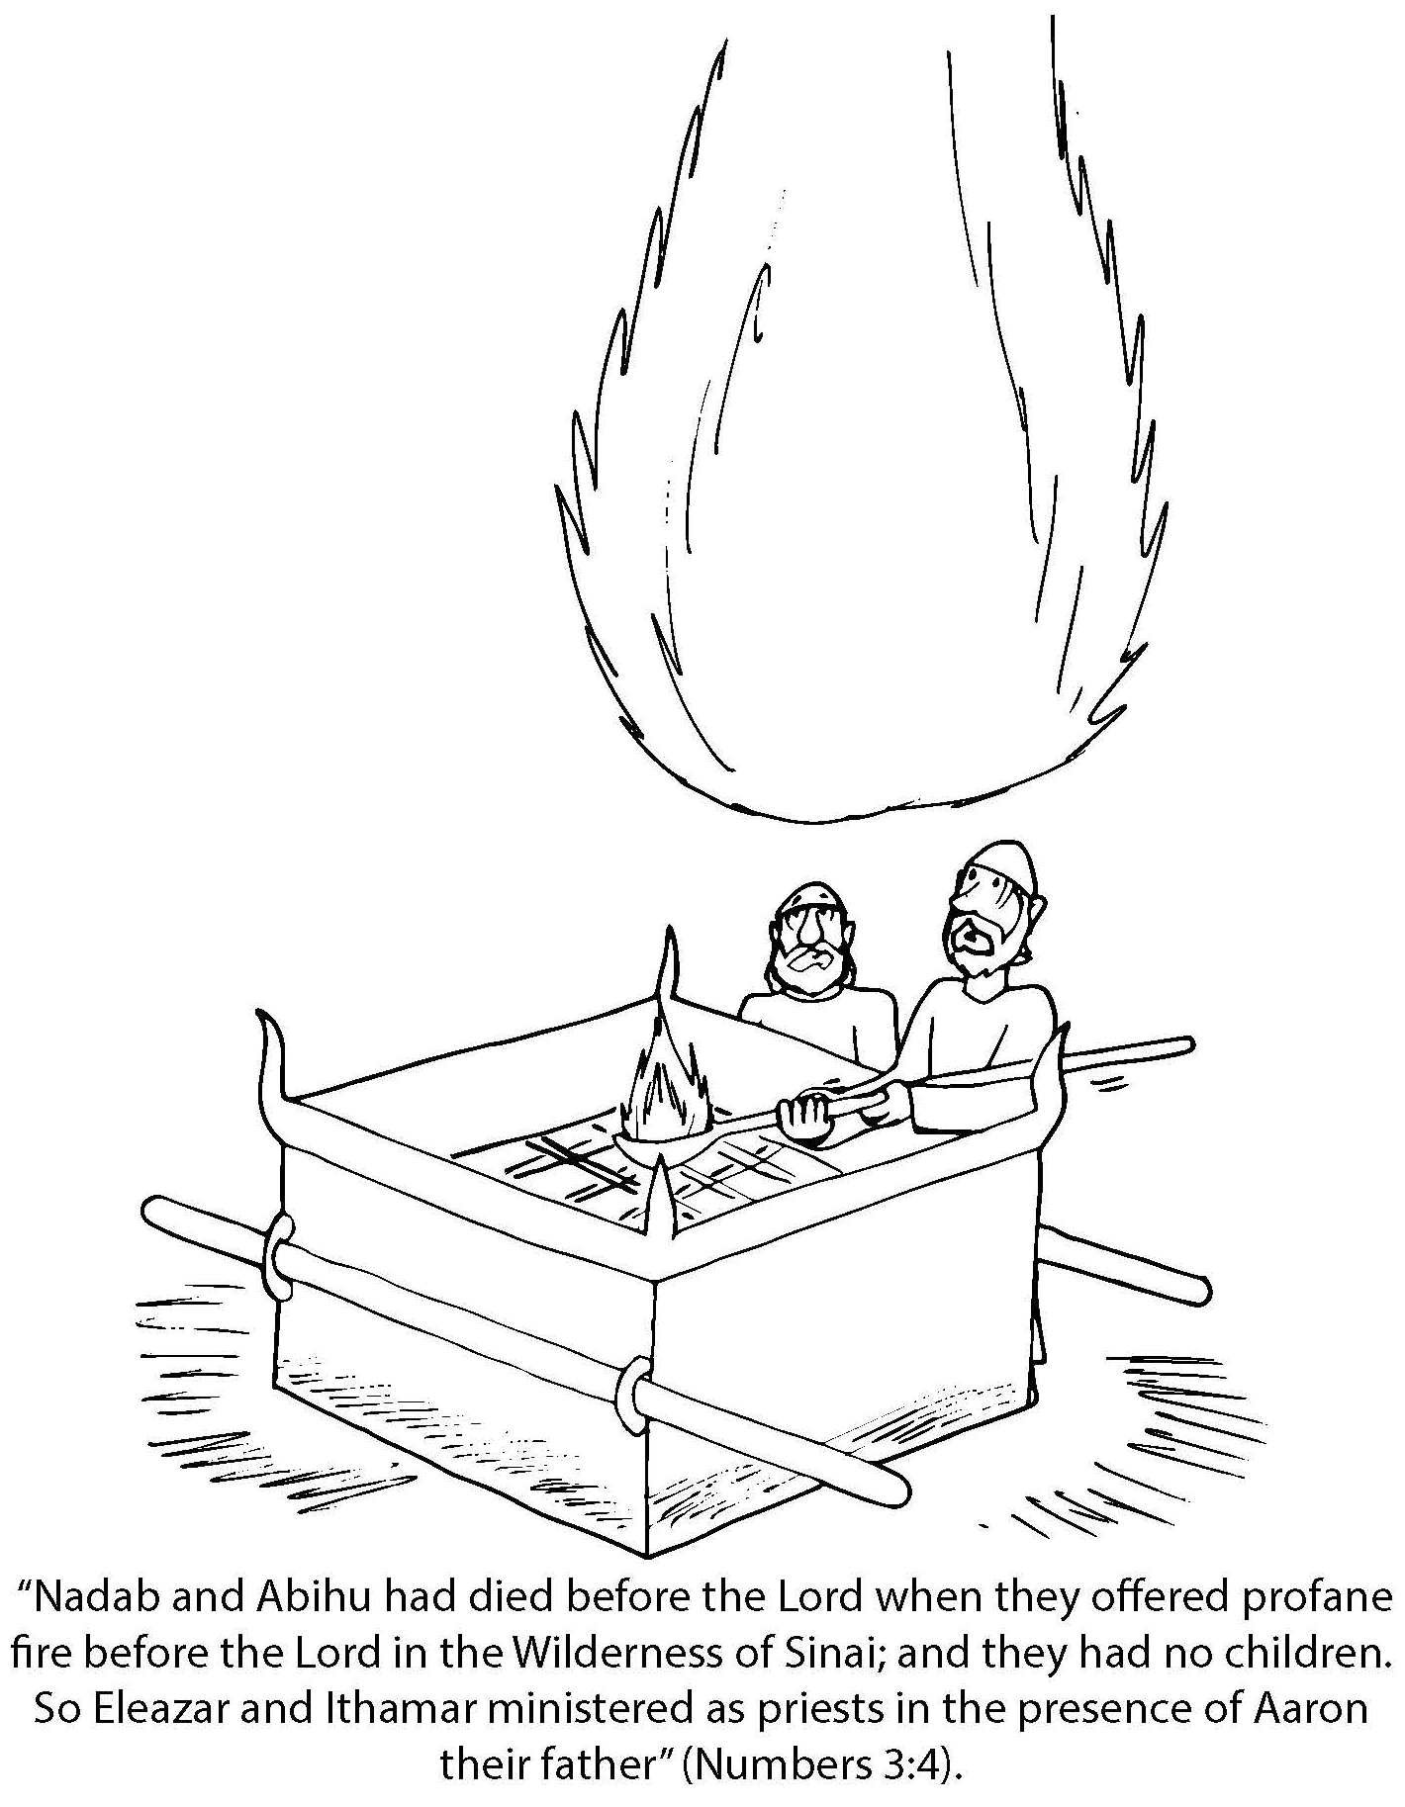
Booneville Church of Christ 4 Year Old Bible Class
Quarter 3, Lesson 3
Today’s Lesson | Nadab and Abihu Leviticus 10:1-7
Questions for Review | What bad choice did Nadab and Abihu make with their offerings? They offered “strange fire” to burn incense at the tabernacle. They did not have permission to use that type of fire. What happened to them? God sent fire to burn them. What are the acts of worship today? Praying, Singing, Giving, Communion, Study of God’s Word.
Memory Work | Books of the Bible Joshua 1:9
Next Week’s Lesson | The Twelve Spies Numbers 13-14

Slide 4
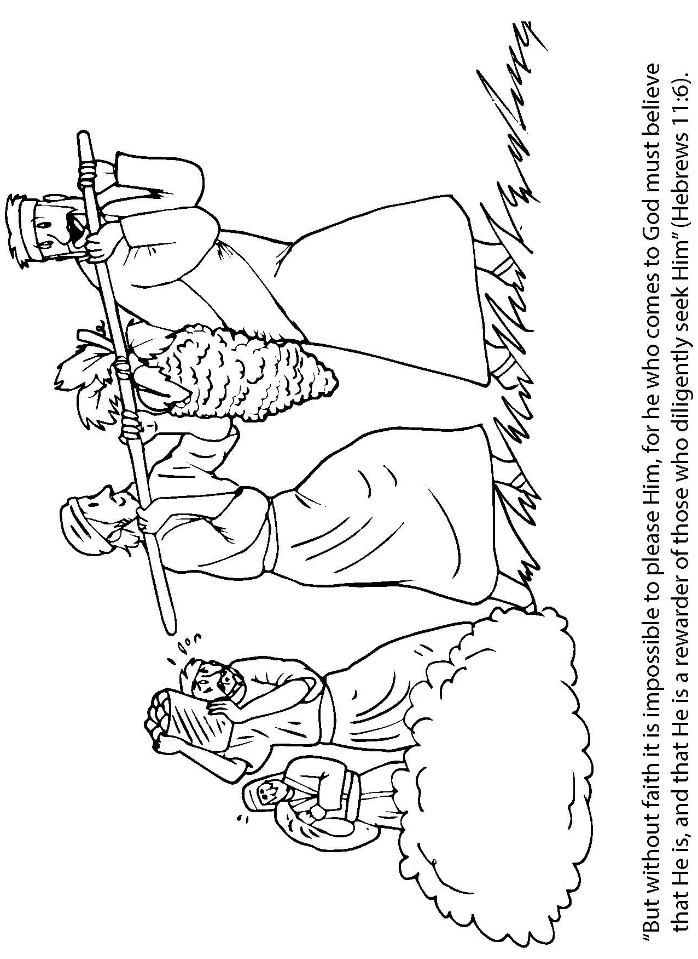
Booneville Church of Christ 4 Year Old Bible Class
Quarter 3, Lesson 4
Today’s Lesson | The Twelve Spies Numbers 13-14
Questions for Review | How many spies were sent to Canaan? 12 What kind of report did the spies have? Ten spies said the people were like giants and the Israelites could not defeat them. Two said they could conquer the land with God’s help. Which spies gave a good report? Joshua and Caleb How did God punish the people for their lack of faith? They had to wander in the wilderness for 40 years, so they didn’t go into the Promised Land.
Memory Work | Books of the Bible Joshua 1:9
Next Week’s Lesson | Moses Strikes the Rock/Bronze Serpent Numbers 20; 21:4-9; 27:14

Slide 5
Booneville Church of Christ 4 Year Old Bible Class
Quarter 3, Lesson 5
Today’s Lesson | Moses Strikes the Rock/Bronze Serpent Numbers 20; 21:4-9; 27:14
Questions for Review | What did God tell Moses to do to the rock? Speak to it Who did Moses do to the rock? He struck the rock and he said that he brought water from the rock instead of honoring God who really gave the water. What was Moses’s punishment? He couldn’t go in the Promised Land. What punishment did God send when the Israelites complained, again, about not having water? Poisonous snakes. Which man was released from prison? The butler How were the Israelites healed? They had to look at the bronze serpent.
Memory Work | Books of the Bible Joshua 1:9
Next Week’s Lesson | Moses’s Death/Joshua Becomes Leader Numbers 27:15-23

Slide 6
Booneville Church of Christ 4 Year Old Bible Class
Quarter 3, Lesson 6
Today’s Lesson | Moses’s Death/Joshua Becomes Leader Numbers 27:15-23
Questions for Review | Who did God choose to replace Moses as leader of the Israelites? Joshua. Who buried Moses? God What did God tell Joshua to do? Be strong and courageous.
Memory Work | Books of the Bible Joshua 1:9
Next Week’s Lesson | Battle of Jericho/Rahab Joshua 1-4

Slide 7
Booneville Church of Christ 4 Year Old Bible Class
Quarter 3, Lesson 7
Today’s Lesson | Battle of Jericho/Rahab Joshua 1-4
Questions for Review | Who hid the spies who were sent into Jericho? Rahab What was her reward? She would not be killed when Jericho was destroyed What happened when the priests carrying the Ark of the Covenant touched the Jordan River? The water stopped flowing so the men could walk across on dry land. What happened when the Israelites followed God’s instructions for marching around Jericho? The walls came down.
Memory Work | Books of the Bible Joshua 1:9
Next Week’s Lesson | Purposes of Judges/Gideon Judges 6-8:35

Slide 8
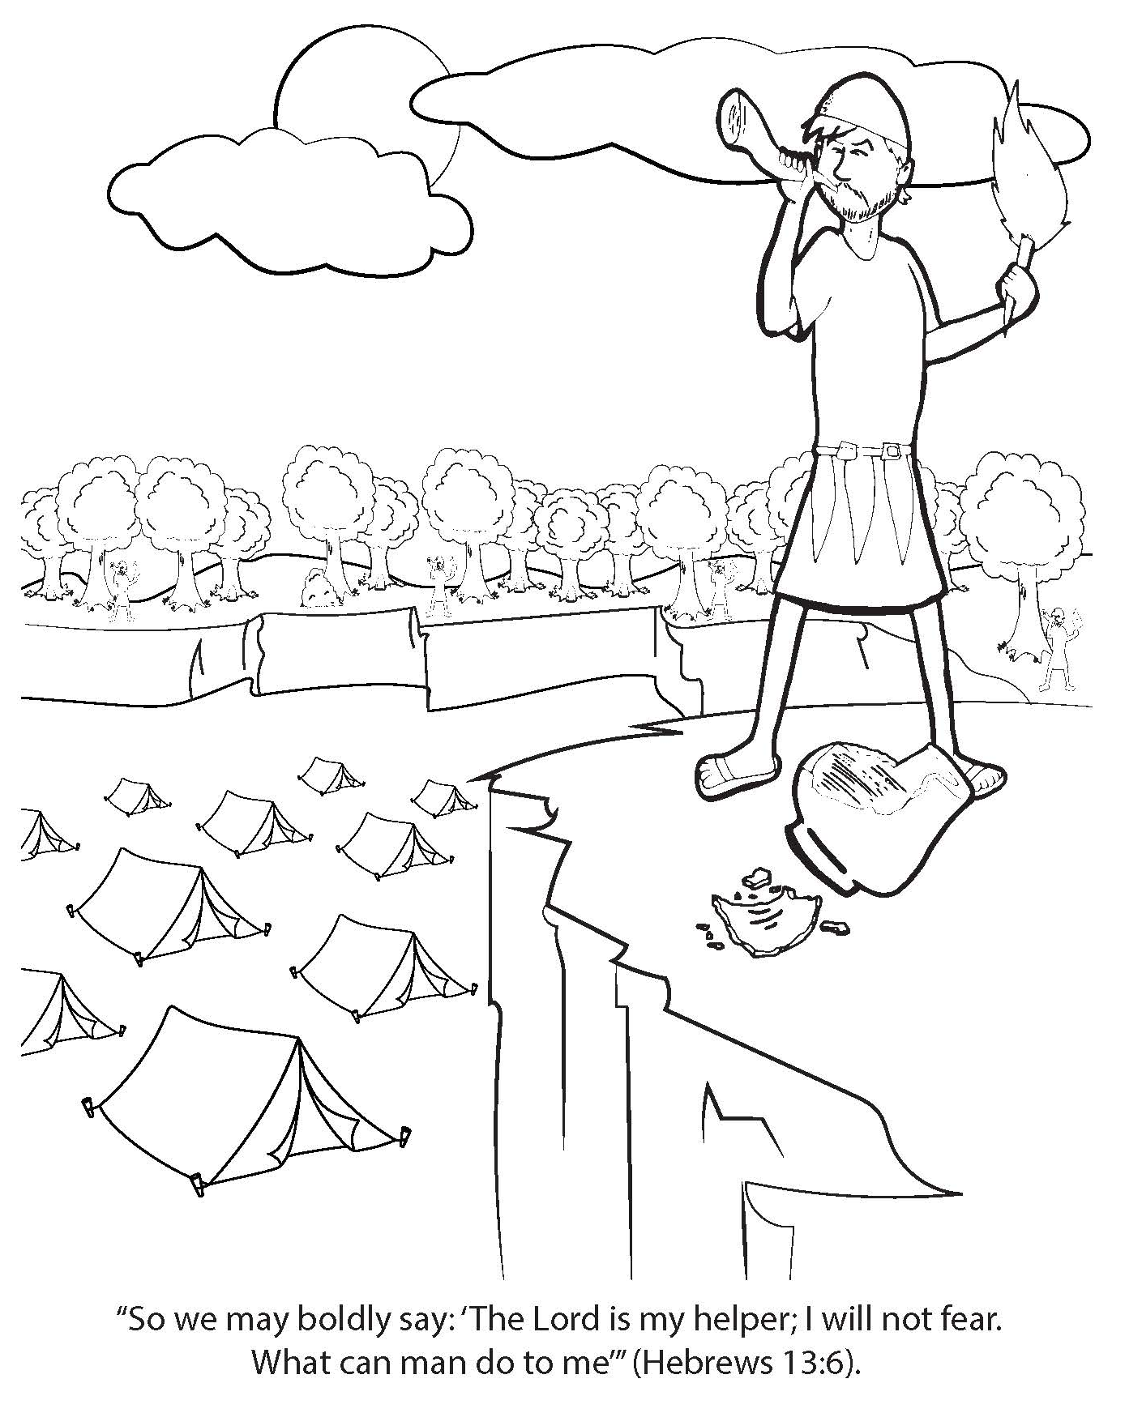
Booneville Church of Christ 4 Year Old Bible Class
Quarter 3, Lesson 8
Today’s Lesson | Purposes of Judges/Gideon Judges 6-8:35
Questions for Review | How did God deliver the Israelites from their enemies? He chose leaders known as judges. Which judge did God use to deliver the Israelites from the Midianites? Gideon How many men did God choose to fight the Midianites? 300 How did God defeat the Midianites? He had the Israelites blow trumpets and break pitchers. The Midianites thought that a large army was attacking them, and they started to kill each other in a panic
Memory Work | Books of the Bible Joshua 1:9
Next Week’s Lesson | Samson’s Early Life Judges 13-15

Slide 9
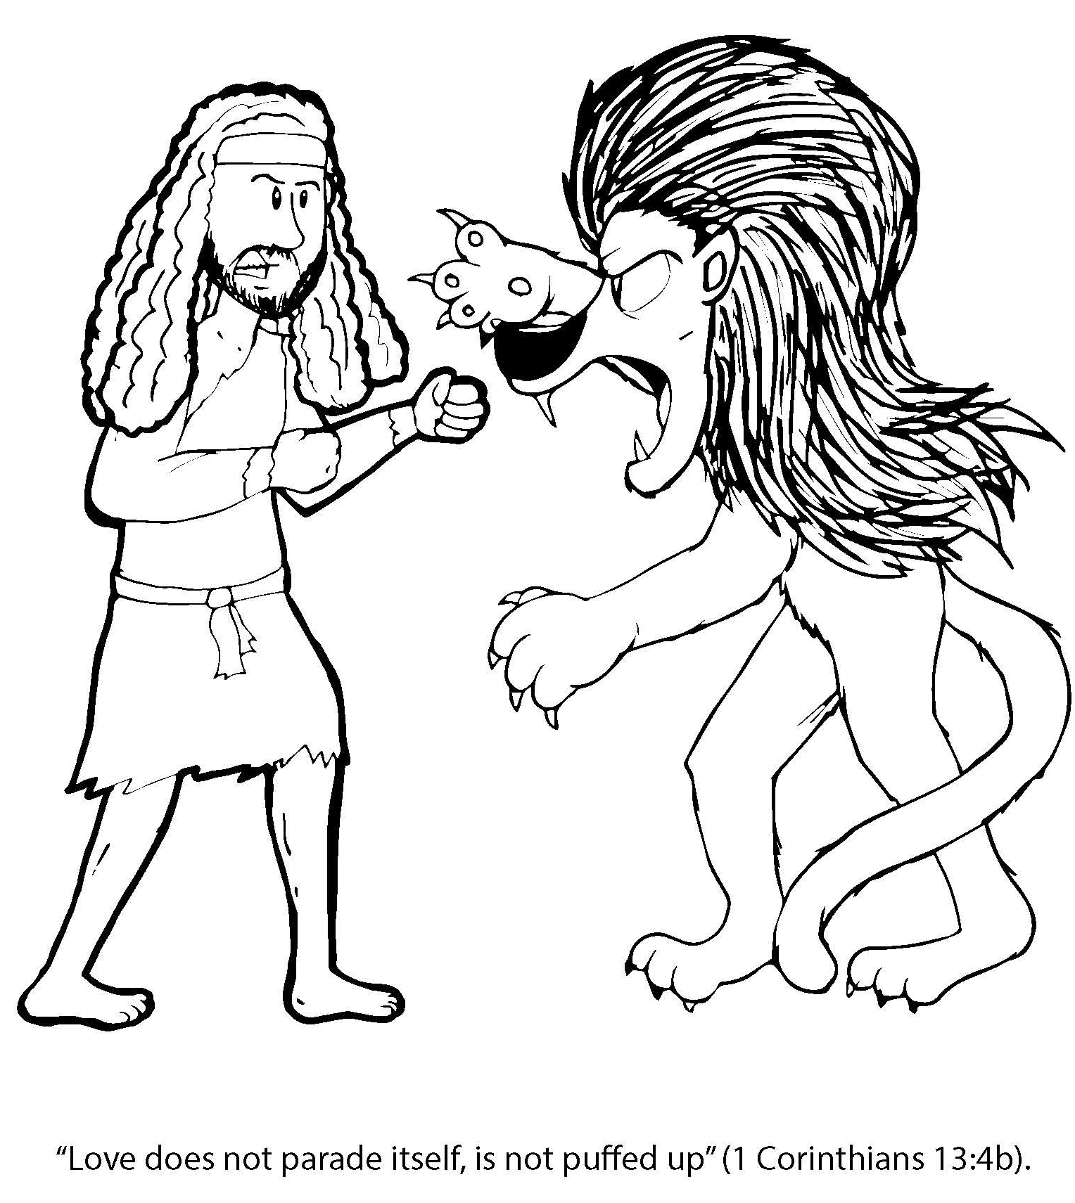
Booneville Church of Christ 4 Year Old Bible Class
Quarter 3, Lesson 9
Today’s Lesson | Samson’s Early Life Judges 13-15
Questions for Review | What type of vow did Samson have? Nazarite. What was Samson to stay away from? He couldn’t have strong drink or cut his hair What did Samson use to kill the lion? His bare hands
Memory Work | Books of the Bible Joshua 1:9
Next Week’s Lesson | Samson and Delilah Judges 16

Slide 10
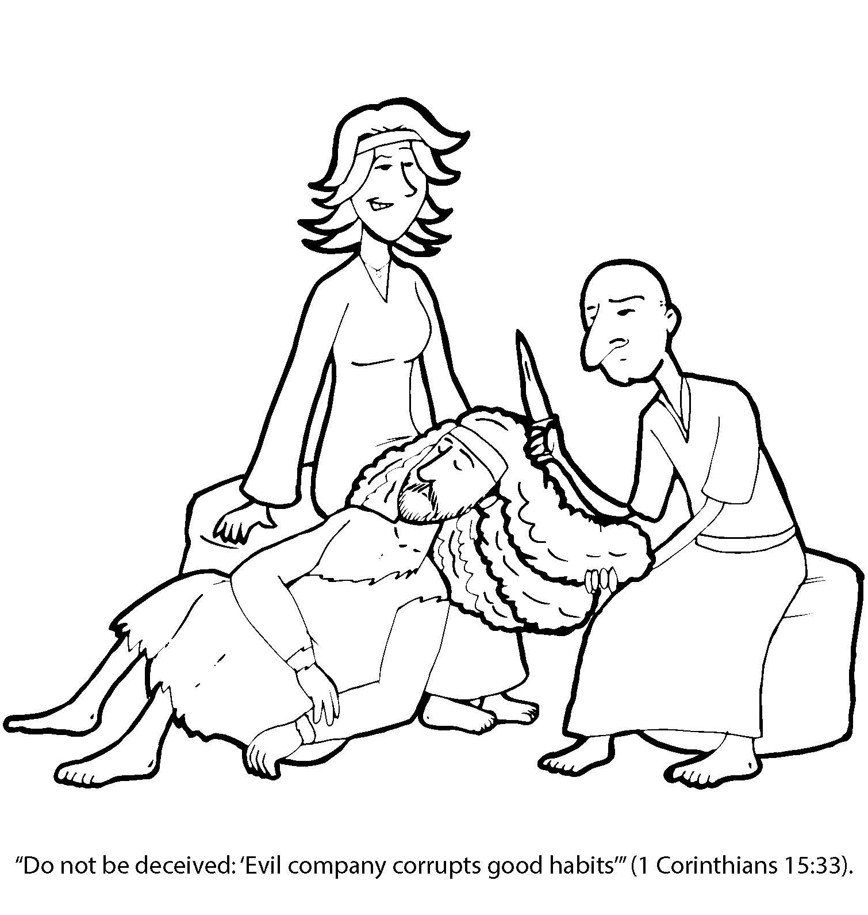
Booneville Church of Christ 4 Year Old Bible Class
Quarter 3, Lesson 10
Today’s Lesson | Samson and Delilah Judges 16
Questions for Review | What was Samson's great gift from God? strength Who got Samson to tell where his strength came from? Delilah What did the Philistines do when they captured Samson? They plucked out his eyes and put him in prison. How did Samson kill many Philistines? God gave him strength and he pushed down the pillars of the building and the people were crushed.
Memory Work | Books of the Bible Joshua 1:9
Next Week’s Lesson | Ruth The book of Ruth

Slide 11
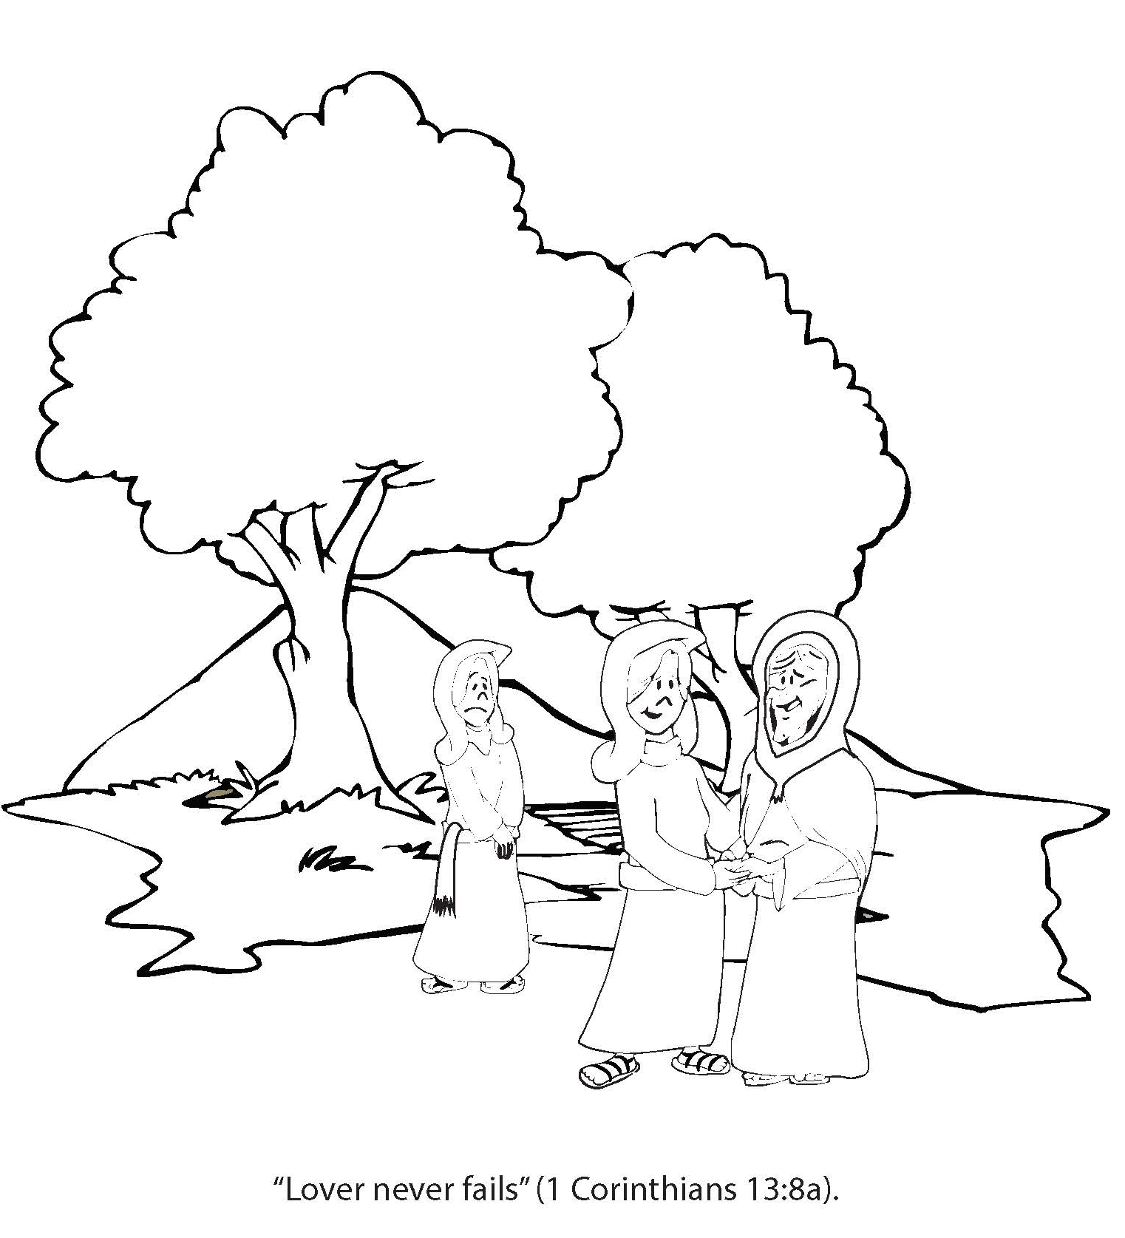
Booneville Church of Christ 4 Year Old Bible Class
Quarter 3, Lesson 11
Today’s Lesson | Ruth The book of Ruth
Questions for Review | Who went with Naomi back to Canaan? Ruth How did Ruth take care of Naomi in Cannon? She gathered food for her from Boaz’s field. Who eventually married Ruth? Boaz
Memory Work | Books of the Bible Joshua 1:9
Next Week’s Lesson | Hannah Prays for a Son I Samuel 1-2

Slide 12
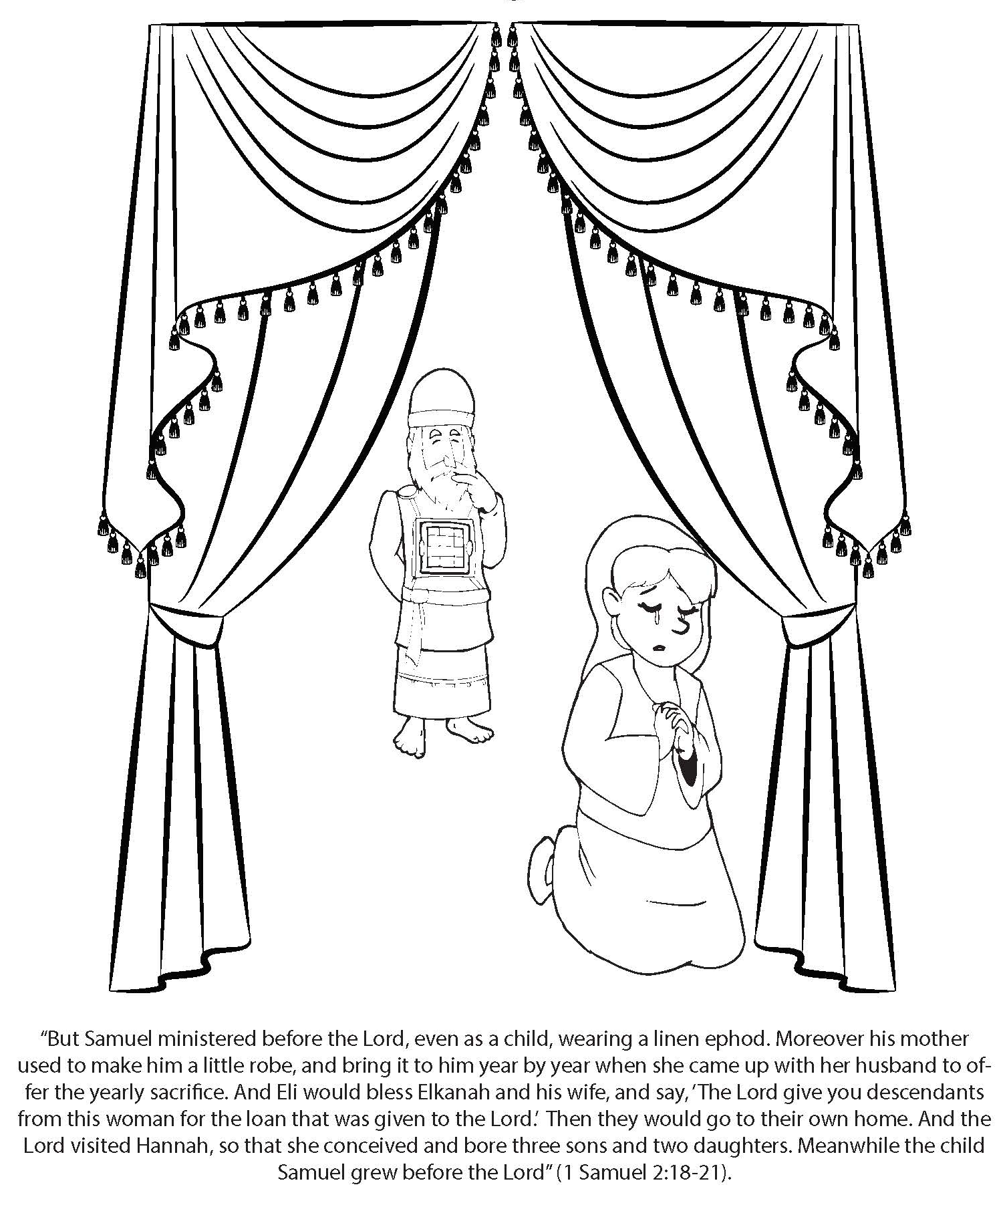
Booneville Church of Christ 4 Year Old Bible Class
Quarter 3, Lesson 12
Today’s Lesson | Hannah Prays for a Son I Samuel 1-2
Questions for Review | Why did Hannah go to the Tabernacle to pray? To ask God to give her a son What did Hannah promise God if He answered her prayer? She would bring the child back to Shiloh to serve the Lord all his life. What was the name of Hannah’s son? Samuel How did Hannah keep her promise to God? While he was young, Hannah brought Samuel to Eli the priest to serve him in the Tabernacle.
Memory Work | Books of the Bible Joshua 1:9
Next Week’s Lesson | God Calls Samuel I Samuel 2-3

Slide 13
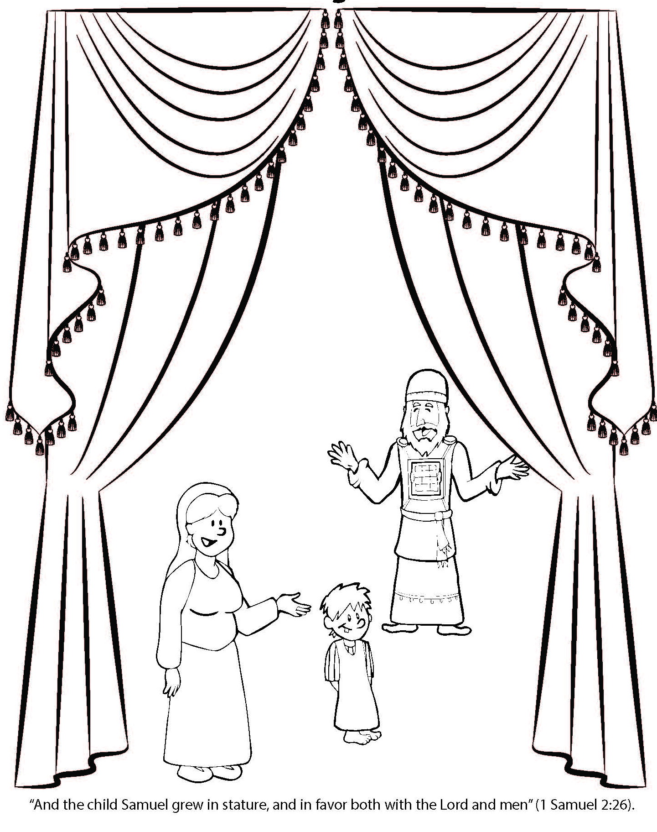
Booneville Church of Christ 4 Year Old Bible Class
Quarter 3, Lesson 13
Today’s Lesson | God Calls Samuel I Samuel 2-3
Questions for Review | How many times did it take Samuel to realize to was God speaking to him? 3 times What did Samuel say to God? Speak, for your servant hears. What did God tell Samuel? Eli’s sons would die because of their great sins against.
Memory Work | Books of the Bible Joshua 1:9
Next Week’s Lesson | Saul Chosen as King I Samuel 7:17-12:25

